Slide 1
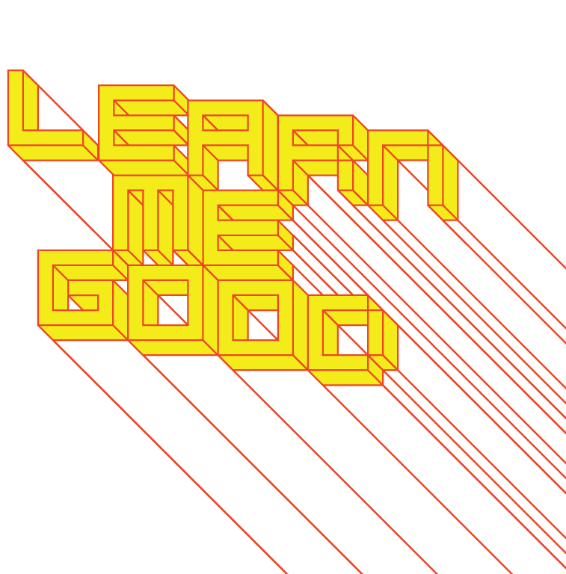
WEEK 3

Slide 2
week 3: scientific management & the division of labour
+ Brian Eno, Ambient 1: Music for Airports
+ “Whereas the various purveyors of canned music proceed from the basis of regularizing environments by blanketing their acoustic and atmospheric idiosyncracies, ambient music is intended to enhance these. Whereas conventional background music is produced by stripping away all sense of doubt and uncertainty (and thus all genuine interest) from the music, ambient music retains these qualities. And whereas their intention is to ‘brighten’ the environment by adding stimulus to it (thus supposedly alleviating the tedium of routine tasks and leveling out the natural ups and downs of the body rhythms) ambient music is intended to induce calm and a space to think. Ambient music must be able to accommodate many levels of listening attention without enforcing one in particular; it must be as ignorable as it is interesting.”
.

Slide 3
week 3: scientific management & the division of labour
+ Overview + Heads-Up:
+ Presentation
+ Division of labour
+ Taylorism
+ Post-industrial society
+ Tutorial Today
+ Writing skills, organization, preparing a thesis statement
+ Questions regarding course/assignments/article summaries
+ Clarification of expectations, website access, etc.
+ Optional Content
+ Radio Broadcast: NUMMI: This American Life (Act two)
+ Women of the World. Dir. Jacopetti, Cavara, Prosperi, 1963.

Slide 4
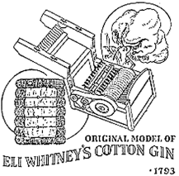
week 3: scientific management & the division of labour
+ Division of Labour
+ "...breakdown into specific, circumscribed tasks for maximum
efficiency of output"
+ Did not exist before agriculture and the beginnings of "civilization"
+ Wholeness of pre-civilized life: absence of the narrowing,
confining separation of people into differentiated roles
and functions
+ American System of Manufacturing, Eli Whitney (1799)
+ Semi-skilled labour using machine tools and templates (or jigs)
+ Make standardized, identical, interchangeable parts,
manufactured to a tolerance (screws, bolts, etc.)
+ Previously, companies developed autonomously
+ Train unskilled labourers
+ Only know how to do one task, thus paying them a lower wage
+ Little concern for health/well-being, as there was a steady supply
+ One of the first applications was the assembly line
+ First introduced by Eli Whitney to manufacture muskets
for the U.S. Government
+ Henry Ford later introduced the moving assembly line to
his Highland Park Ford Plant to cut manufacturing costs
and deliver a cheaper product

Slide 5
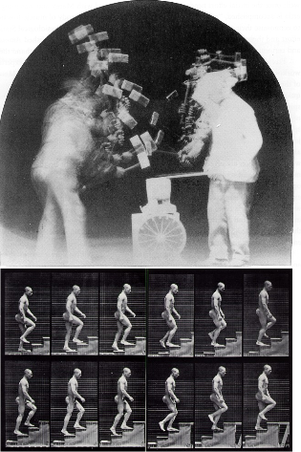
week 3: scientific management & the division of labour
+ Division of Labour
+ "Taylorism" or Scientific Management:
+ Name of the approach to management and
industrial/organizational psychology
initiated by Frederick Winslow Taylor
+ "The Principles of Scientific Management" (1911)
+ Relied on time and motion studies to find the
"one best method" to achieve a goal
+ Influenced by Eadweard Muybridge
+ No unnecessary or extra movements
+ This task-oriented optimization of work is
nearly ubiquitous today in menial
industries (assembly lines, fast food, etc.)
+ "On the Line, A People's Century" (PBS, 2:45-14:40,
15:05-36:05)
+ Management sets the pace; machines set the pace;
workers become machines
+ "Fordism":
+ References Henry Ford's mass production techniques in
the early 20th century
+ Also refers to the cult of Ford worshippers in Aldous
Huxley's Brave New World (4:20-11:00)
+ A critical indictment of the dystopian world he predicted
through the division of labour and industrial progress ("negative utopia")

Slide 6
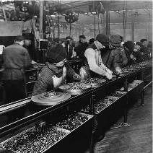
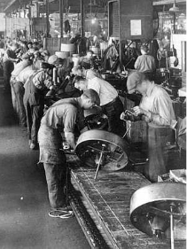
week 3: scientific management & the division of labour
+ Failed Utopia: The Workers Revolt
+ "You all remember, I suppose, that beautiful and inspired saying of
Our Ford's: History is bunk." - Aldous Huxley, Brave New World
+ Problems With Taylorism:
+ Ignores individual differences: the most efficient way of
working for one person may be inefficient for another
+ Ignores the fact that the economic interests of workers and
management are rarely identical
+ Both the measurement processes and the retraining
required by Taylor's methods would frequently be
resented and sometimes sabotaged
+ Karl Marx:
+ Increasing specialization may also lead to workers with
poorer overall skills and a lack of enthusiasm for their
work (alienation)
+ Workers become more and more specialized, and their tasks
increasingly repetitious, leading to complete alienation
+ "...as a result of division of labor," the worker is "reduced
to the condition of a machine."
+ Dehumanization, leading to political and social unrest
+ "When the individual feels, the community reels."
- Aldous Huxley, Brave New World

Slide 7
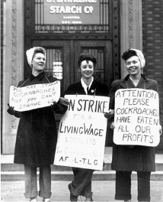
week 3: scientific management & the division of labour
+ Failed Utopia: The Workers Revolt
+ "The greater a man's talents, the greater his power to be led
astray. It is better that one should suffer than that many should
be corrupted. Consider the matter dispassionately, Mr. Foster,
and you will see that no offense is so heinous as unorthodoxy of
behavior. Murder kills only the individual - and, after all, what is
an individual?"
- Aldous Huxley, Brave New World
+ "Metropolis," dir. Fritz Lang (1927)
+ German expressionist masterpiece
+ Dystopian futurist vision of an industrialized society
+ "I Love Lucy, Job Switching" (1952)
+ Satire and critical reflection on industrial society enters
into popular culture

Slide 8
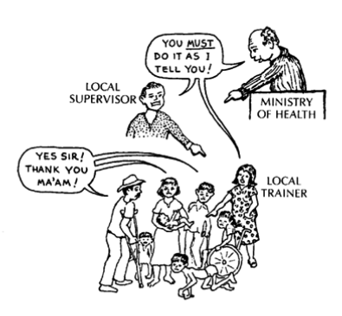
week 3: scientific management & the division of labour
+ Top-Down Versus Bottom-Up Management
+ Michael Singer Dobson, "The Power of Top-Down Change”, Working With Difficult People:
+ "The conventional attack is to start at the
bottom of the chart and work your way up,
providing knowledge, working to change
attitudes and so forth, in turn. What is not
as intuitive is that top-down change is
often more effective - in other words,
enforcing a change in organizational
behavior and letting the change filter down
to the level of knowledge. The military uses
top-down changes in basic training - for
example, by making new recruits drill
immediately - with the knowledge that
attitudes and eventually understanding will
follow, and in most cases, it does.
Parents use top-down change with young
children; it's not necessary that the two-
year-old know that playing in the street is dangerous
or even to have a good attitude about not playing in the
street - those things will come in time, and obviously
much more effectively if the child is still alive."

Slide 9
week 3: scientific management & the division of labour
+ Adoption and Normalization of Scientific Management
+ Top-down approach and division of labour enter into other areas of work:
+ Not simply manufacturing economy
+ Many times it is disguised with perks and other benefits to conceal the hierarchical
structure
+ For example, many large tech companies
+ This management structure has become so naturalized
into our culture that we come to accept it or mock it in
popular media and the arts
+ "Office Space" (1999):
+ Rebellion; anti-corporate behaviour
+ Subversion, "making do" (Michel de Certeau)

Slide 10
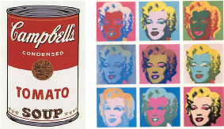
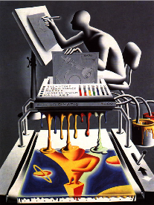
week 3: scientific management & the division of labour
+ Labour as a Conceptual Model
+ Andy Warhol's Factory
+ The "game" of pop art; entrance of artist into
"superstardom"
+ Use of paid labour and industrial processes
+ Production of multiple "originals"
+ Manager of the art process
+ Mark Kostabi
+ Openly employed artists to paint his works in his signature
style ($5-$20/hour)
+ Produced through committees of idea people, artists and
others
+ "Most artists steal their ideas, I pay for mine."
+ "In Kostabi World it's all work for hire. Even when they're
doing creative things, even when they're pouring their
heart and souls into an idea...that's their prerogative to
do that. They're just doing their job description. I mean it's
their prerogative if they want to pour their heart and soul
into it, which I appreciate, but there's no obligation to do
that. I just want them to do a good job."

Slide 11
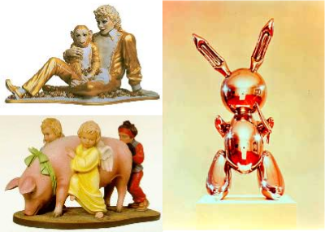
week 3: scientific management & the division of labour
+ Labour as Conceptual Model
+ Jeff Koons
+ Former Wall Street commodities broker
+ Hires craftspersons to do his work
+ Subject matter drawn from kitsch and
banal popular culture

Slide 12
week 3: scientific management & the division of labour
+ Labour After Labour
+ Post-Industrial Society:
+ A proposed name for an economy that has undergone a specific series of changes in
structure after a process of industrialization
+ Such societies are often marked by:
+ Rapid increases in the size of the service sector, as opposed to manufacturing,
+ Increased amounts of information technology, often leading to an "Information
Age"
+ Information, knowledge, and creativity are the new raw materials of such an
economy
+ Knowledge Economy:
+ Refers to the use of knowledge to produce economic benefits
+ Initially referred to the manner in which various high-technology businesses,
especially computer software, telecommunications and virtual services, as well as
educational and research institutions, can contribute to a country's economy
+ Richard Florida, The Rise of the Creative Class
+ Core Group (innovators): "...people in science and engineering, architecture and design, education, arts, music, and entertainment, whose economic function is to create new ideas, new technology, and/or new creative content."
+ Broader Group (facilitators): "...in business, finance, law, and health care [who] engage in complex problem solving that involves a great deal of independent judgment and requires high levels of
education or human capital."
+ Shift from manufacturing base in developed nations (result of globalization and outsourcing)

Slide 13
week 3: scientific management & the division of labour
+ Case Studies: The Auto Industry
+ The Saturn Paradigm (est. 1985)
+ "A Different Kind of Car Company." (1990 campaign)
+ Re-establish relationship between producer and
consumer
+ Owners become part of a club
+ Pilgrimage to witness "birth," picnics, rallies, etc.
+ "Carla" was 500,000th (1993), "Jasper" was
1,000,000th (1995)
+ Volkswagen Factory, Dresden / Autostadt, Wolfsburg
+ Glorification of the manufacturing process - performance
+ In the wake of the new economy which de-emphasizes manufacturing
+ Relationship to Contemporary Auto Industry
+ Labour and economic issues
+ New workforces require new models for production and management
+ New models: "The Toyota Way":
+ "Lean Manufacturing," "Mixed-Model Production"
+ "Jidoka" (automation with a human touch), "Just in Time" (JIT)
+ NUMMI (New United Motor Manufacturing Inc.)
+ Joint venture between GM and Toyota in Freemont, CA (1984-2010)
+ Radio Broadcast: NUMMI: This American Life

Slide 14
week 3: scientific management & the division of labour
+ Reflective Summaries (15% - 5% each; due Sept. 26, Oct. 24, Nov. 14)
+ Based on readings from previous two weeks (1-3 / 4-6 / 7-9)
+ Select one reading/website/film on which to focus
+ Select an everyday artifact/object/ritual/graphic image to illustrate (or contradict) one of the main
concepts of the chosen reference
+ May be contemporary or from a previous era (CANNOT be an example referred to in article or class presentations)
+ Relate the artifact to the article, including the following:
+ An overview of the specific qualities, characteristics, and connotations that connect it to
the reading/resource
+ A summary of how the artifact relates to the general themes of the lecture on that week
+ An indication of key historical and political influences from the era of the artifact’s production
+ A statement on how it activates/reflects the culture of its time and place
+ Format: 500 words, PDF format
+ Include: title, name, id, course, date, name of artifact
+ Include a photograph of the selected artifact
+ Upload digital copy to Moodle

Slide 15
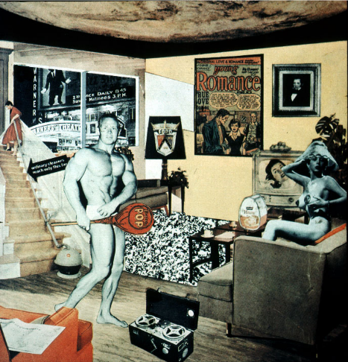
week 3: scientific management & the division of labour
+ Major Assignment: "Just What is it That Makes Today’s Homes So Different, So Appealing?”
+ Part 1: Research (30%, due October 31)
+ Part 2: Integration (40%, due November 28)
+ Richard Hamilton (1956)

Slide 16
week 3: scientific management & the division of labour
+ Major Assignment: "Just What is it That Makes Today’s Homes So Different, So Appealing?”
+ Overview:
+ Commit to a specific artifact, live with it, document your interactions/environment/context of use
+ Can be almost anything (shampoo, coffee cup, typeface, etc.) - be specific!
+ Collection of information, texts, photographs that help you to better understand the life and story
of your artifact
+ Determine how it influences, and is influenced by the culture/world in which it operates
+ Will be the subject of your entire semester of research--choose carefully!
+ Part 1: Research (30%, due October 31)
+ Anthropological field study
+ Section 1:
+ Explain your choice; personal resonance/significance
+ Describe its physical characteristics; 10 captioned photos, brief text
+ Detailed description of its contextual environments; 5 captioned in-situ photos, brief text
+ Capture within its natural environment
+ Section 2:
+ 10 captioned images of different but comparable products; same codes/cultural signals and
connotations (cannot be different brands of same artifact type)
+ Choose 4 photos to elaborate on how each expands your understanding of the original artifact
+ Section 3:
+ Summary/Conclusions
+ Format:
+ PDF presentation
+ 25 captioned photos; approximately 750 words (not including captions)

Slide 17
week 3: scientific management & the division of labour
+ Heads-Up:
+ Optional Content:
+ Radio Broadcast: NUMMI: This American Life
+ Video excerpts: Women of the World. Dir. Jacopetti, Cavara, Prosperi, 1963.
+ Reading:
+ Coffin, Judith. “Credit, Consumption, and Images of Women’s Desires: Selling the Sewing
Machine in Late Nineteenth-Century France.” French Historical Studies vol. 18, no. 3, 1994,
pp. 749-783.
+ PDF available online
+ It's a bit lengthy, but very fascinating
+ First Article Summary due September 26 (NEXT WEEK!)
+ Based on readings from weeks 1-3

