Slide 1
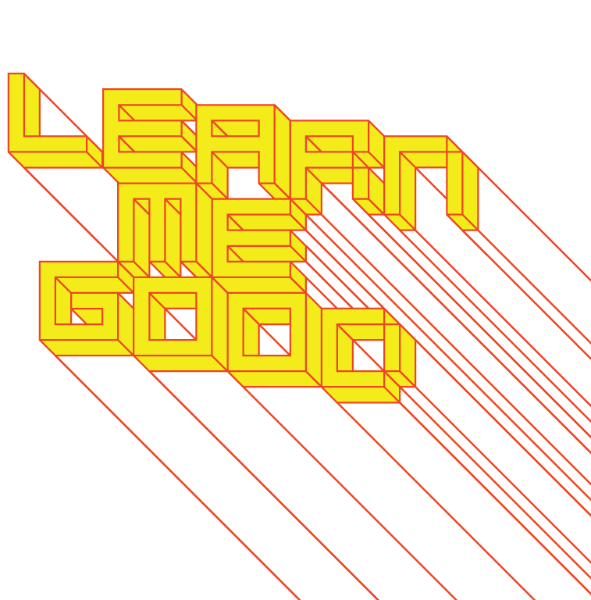
WEEK 6

Slide 2
week 6: brands, propaganda + identity (continued)
+ Thoughts:
+ And you may find yourself living in a shotgun shack And you may find yourself in another part of the world And you may find yourself behind the wheel of a large automobile And you may find yourself in a beautiful house, with a beautiful wife And you may ask yourself, "Well, how did I get here?"
…
You may ask yourself, "What is that beautiful house?"
You may ask yourself, "Where does that highway go to?"
And you may ask yourself, "Am I right, am I wrong?"
And you may say to yourself, "My God, what have I done?”
- Talking Heads, “Once in a lifetime”

Slide 3
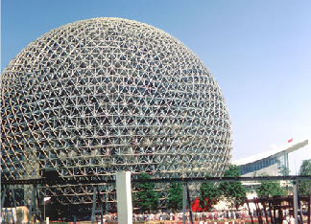
week 6: brands, propaganda + identity (continued)
+ Overview + Heads-Up:
+ Presentation:
+ Continuation of branding lecture
+ Propaganda and Marketing
+ Optional:
+ Video: The World of Buckminster Fuller.
Dir. Robert Snyder
+ Heads-Up
+ Second Article Summary is due next week (Oct. 24)
+ Based on readings from weeks 4-6

Slide 4
week 6: brands, propaganda + identity (continued)
+ Brand Identity: The Advertised Life
+ Tom Vanderbilt: "the advertised life is an emerging mode of being in which advertising
not only occupies every last negotiable public terrain, but in which it penetrates the
cognitive process, invading consciousness to such a point that one expects and looks
for advertising, learns to lead life as an ad, to think like an advertiser, and even to
anticipate and insert oneself in successful strategies of marketing."
+ Michael Jordan in Space Jam: “Michael, it’s show time. Get your Hanes on, lace up your
Nikes, grab your Wheaties and Gatorade, and we’ll pick up a Big Mac on the way!”
+ “Product Idea”: more important than the product, itself
+ NikeTown, Roots Lodge, Hilton to Home, Celebration, for example: total brand experience
+ Living inside a “perpetual marketing event” (from Advertising Age)

Slide 5
week 6: brands, propaganda + identity (continued)
+ What is Brand Identity?
+ Brand as product:
+ Link brand to product class (Band-Aid, Kleenex)
+ Better than competition + quality/value
+ Association with use occasion or user or country/region
+ Brand as organization:
+ Attributes of company, rather than specific products (Saturn)
+ Brand as person:
+ Based upon human factors, personality (Apple)
+ Brand as symbol:
+ Vivid, meaningful - often use visual metaphor (Nike, McDonalds)

Slide 6
week 6: brands, propaganda + identity (continued)
+ What is Brand Identity?
+ Identity structure:
+ Core = timeless essence of the brand
+ Extended = provide texture and completeness
+ Value proposition:
+ Functional benefits (Volvo is safe because…)
+ Emotional benefits (I feel safe in a Volvo)
+ Self-expressive benefits (I am sporty by wearing Nike: “Just do it”)
+ Brand-customer relationship
+ "We're a Ford family"

Slide 7
week 6: brands, propaganda + identity (continued)
+ What is Brand Identity?
+ "Madison Avenue insists there is deep myth and symbolism going on here, or worse yet,
it makes ridiculous claims of distinctiveness: Describing their entrance into the premium
bottled-water market, a Donna Karan New York executive said that ' it just seems so
right. Water is international. It's real. It's part of you.' Or, as the ad director for
another designer-water brand said, ' Pure. Refreshing – all those adjectives that go with it
describe both us and the water ' (one wonders if 'shallow' and 'transparent' are among
those adjectives)." -- Thomas Vanderbilt, The Advertised Life
+ "Macy’s advertises ' Expressions – Faded attraction … the worn out jean from Calvin Klein
Sport.' ' Worn out in all the right places,' the copy continues, ' brand new jeans slip on
with the look and feel of old favorites. And when Calvin’s cool white crew neck is added
(a soon-to-be new favorite) you’re set for a totally relaxed mood.' "
-- John Fiske, The Jeaning of America
+ Breakout Questions:
+ How are jeans distinguished by brand (generic versus designer)?
+ What are the dominant mythologies around jean marketing?
+ How are these implemented in brand and marketing strategies?

Slide 8
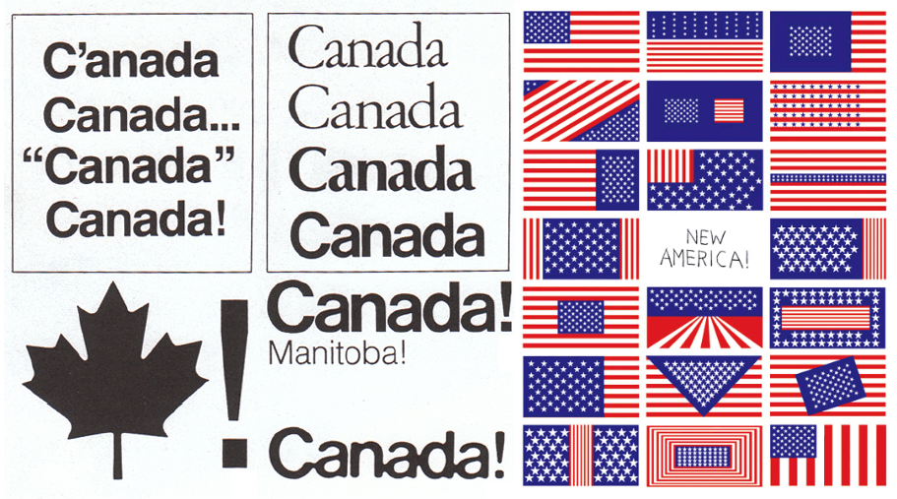
week 6: brands, propaganda + identity (continued)
+ Branding Nations
+ Danny Abelson / Tibor Kalman, Canada Finds an Identity, Finally
+ Kim Hastreiter et al, Rebranding America

Slide 9
week 6: brands, propaganda + identity (continued)
+ Branding Ideology
+ "Brain Scanning Christians for Branding Secrets" (Ad Age / Buy-ology)

Slide 10
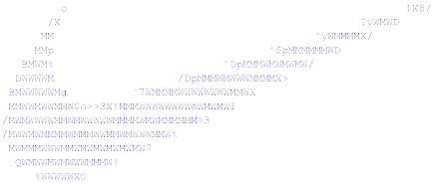
week 6: brands, propaganda + identity (continued)
+ What is marketing?
+ Craft of linking producers of a product/service with customers (existing and potential)
+ Not limited to capitalist countries: applied in all political systems and many aspects of life
+ Methods informed by social sciences: psychology, sociology, economics
+ Marketing research underpins these activities
+ The 4 "P"s: Product + Pricing + Promotion + Place (distribution)
+ Form the marketing mix, used to form the marketing plan
+ For a plan to be successful, the mix of the 4 "P"s must
reflect the wants and desires of the consumers
in the target market
+ Trying to sell to an uninterested market is
expensive and usually unsuccessful
+ Depend on market research to determine
what consumers want and what they
are willing to pay for
+ Marketers hope that this will give them
sustainable competitive advantage

Slide 11
week 6: brands, propaganda + identity (continued)
+ Marketing Research
+ Also called "consumer research"
+ Applied sociological study which concentrates on understanding the behaviours, whims
and preferences, mainly current and future, of consumers in a market-based economy
+ Market Research: business environment; competitors, market structure, government
regulations, economic trends; financial analysis
+ Product Research: what can be produced with available technology; future
innovations
+ Advertising Research: assess the likely impact of an advertising campaign; assess
successes of recent campaigns
+ Buy-ology in the Supermarket

Slide 12
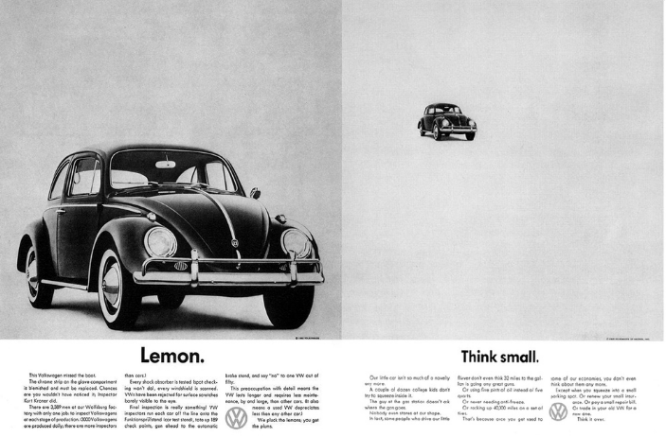
week 6: brands, propaganda + identity (continued)
+ Case Study: When Brand Identity Collapses
+ This American Life: "Put a Bow on it" (starts at ~41:40 – 58:00)
+ 2015 Volkswagon scandal

Slide 13
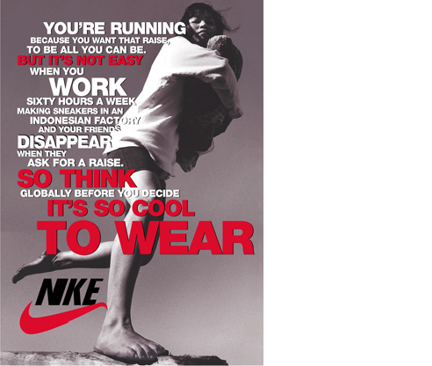
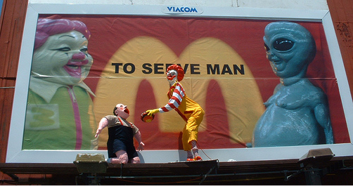
week 6: brands, propaganda + identity (continued)
+ Subversion of Marketing and Branding
+ Adbusters
+ Culture Jamming
+ Billboard Liberation Front
+ Thomas Frank and Dave Mulcahey,
"Consolidated Deviance, Inc."
+ Language
+ Components
+ Rhetorical structure

Slide 14
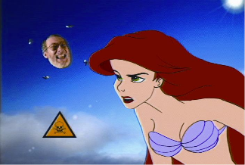
week 6: brands, propaganda + identity (continued)
+ Negativland, "Gimme the Mermaid", "Greatest Taste Around" (fan video)

Slide 15
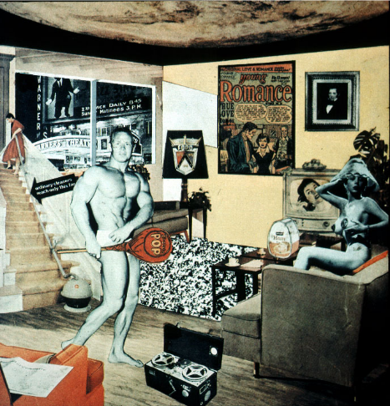
week 6: brands, propaganda + identity (continued)
+ Major Assignment: "Just What is it That Makes Today’s Homes So Different, So Appealing?”
+ Part 1: Research (30%, due October 31)
+ Part 2: Integration (40%, due November 28)
+ Richard Hamilton (1956)

Slide 16
week 6: brands, propaganda + identity (continued)
+ Major Assignment: "Just What is it That Makes Today’s Homes So Different, So Appealing?”
+ Overview:
+ Commit to a specific artifact, live with it, document your interactions/environment/context of use
+ Can be almost anything (shampoo, coffee cup, typeface, etc.) - be specific!
+ Collection of information, texts, photographs that help you to better understand the life and story
of your artifact
+ Determine how it influences, and is influenced by the culture/world in which it operates
+ Will be the subject of your entire semester of research--choose carefully!
+ Part 1: Research (30%, due October 31)
+ Anthropological field study
+ Section 1:
+ Explain your choice; personal resonance/significance
+ Describe its physical characteristics; 10 captioned photos, brief text
+ Detailed description of its contextual environments; 5 captioned in-situ photos, brief text
+ Capture within its natural environment
+ Section 2:
+ 10 captioned images of different but comparable products; same codes/cultural signals and
connotations (cannot be different brands of same artifact type)
+ Choose 4 photos to elaborate on how each expands your understanding of the original artifact
+ Section 3:
+ Summary/Conclusions
+ Format:
+ PDF presentation
+ 25 captioned photos; approximately 750 words (not including captions)

Slide 17
week 6: brands, propaganda + identity (continued)
+ Major Assignment: "Just What is it That Makes Today’s Homes So Different, So Appealing?”
+ Part 2: Integration (40%, due November 28)
+ Connect object to broader culture and theoretical/historical/social framework
+ Section 1:
+ 6 sources of information about object (1+ Library book, 1+ scholarly article, 1+ popular media)
+ Discuss how artifact relates predominant cultural values/ideals (be specific about the time,
location, community, user, etc.)
+ Provide proper citations; credit all borrowed thoughts and references
+ Section 2:
+ Choose one historical artifact (pre-1960) to compare or contrast with your artifact
+ Describe how it reflected its time/culture and how it relates to your contemporary example
+ Section 3:
+ Conclusion
+ How does this study help you to better understand contemporary culture, and your role as a
designer?
+ Format:
+ 2000-word paper, with appropriate citations, title page, etc.
+ Include relevant illustrations/photos/captions
+ Upload copy to Moodle

Slide 18
week 6: brands, propaganda + identity (continued)
+ Heads-Up
+ For Next Week:
+ ONE of:
+ Helfand, Jessica. “Why is This Font Different From All Other Fonts?” Design Observer
+ Arnheim, Rudolf. “The Bauhaus in Dessau.” Graphic Design History
+ ONE of:
+ MacDonald, Juliette. “Design and Modern Culture.” Exploring Visual Culture
+ London, Bernard. “Ending the Depression Through Planned Obsolescence.” Adbusters
+ Spencer, Jane. “Companies Slash Warranties, Rendering Gadgets Disposable.”
The Wall Street Journal
+ Second Article Summary is due in week 7 (next week - Oct. 24)
+ Based on readings from weeks 4-6
+ Optional:
+ Video: The World of Buckminster Fuller.
Dir. Robert Snyder

