Slide 1
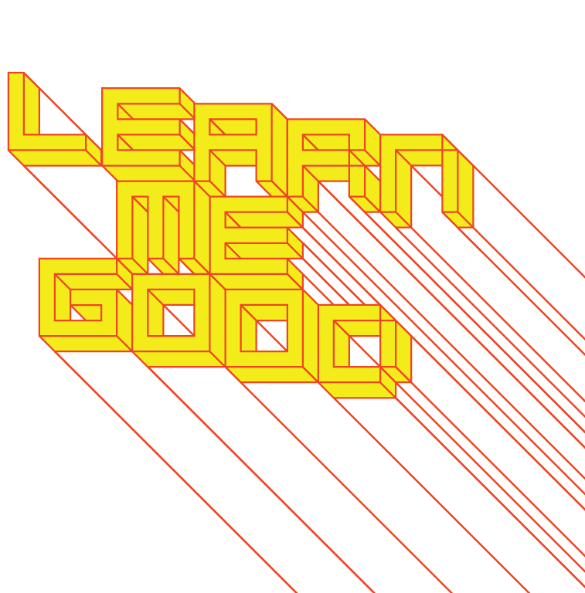
WEEK 2

Slide 2
week 2: william morris, art nouveau + industrialization
+ Overview + Heads-Up:
+ Lecture
+ William Morris and the Arts and Crafts Movement
+ Evolution of Art Nouveau
+ Break
+ Tutorial Activity and Video Screening
+ Arts and Crafts discussion
+ Video screening: Thank You for the Music, Dir. Mika Taanila (20:00)
+ Agendas
+ Note key dates and deliverables

Slide 3
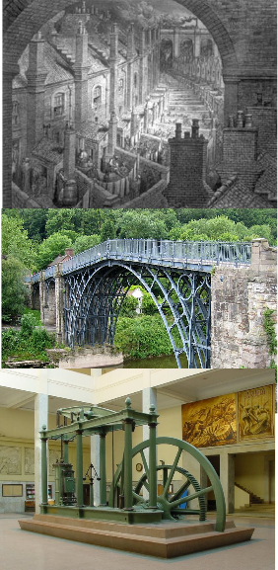
week 2: william morris, art nouveau + industrialization
+ Migration to Cities and the Aesthetic Impacts of Mass Production
+ Early Industrial Revolution:
+ Late 18th - early 19th century (1760-1840)
+ Major shifts in agriculture, manufacturing, mining, and transport
+ Manual labour and animal-based farming shifted to
factory and machine production
+ Result of major developments in science: the dominating
cultural influence of the late 17th - early 18th centuries
+ Change in socio-economic and cultural conditions
+ Almost every aspect of modern life was influenced
+ Mass migration to city centers to seek steady employment
+ Secondary businesses and services to support development
of mass production
+ Cheaper, smaller residences/apartments; proximity to
goods/services
+ Initially began with mechanization of textile industry
+ Trade expansion facilitated by establishment of infrastructure
(canals, roads, railways) and the steam engine

Slide 4
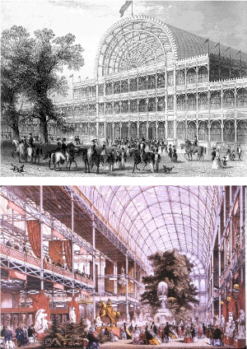
week 2: william morris, art nouveau + industrialization
+ Migration to Cities and the Aesthetic Impacts of Mass Production
+ Impacts:
+ Dramatic increases in production capacity led to longer
work days and division of labour
(the subject of next week's lecture)
+ Workers used as "tools" in the process of automation
+ Decline in common literacy
+ Dramatic health and welfare consequences
+ 1854 Broad Street Cholera Outbreak, London
+ John Snow: contaminated water, not "bad air”
+ Decreased life expectancy
+ Rise of socialism and new forms of political protest,
art, design
+ Aesthetics influenced by the machine age
+ Standardization: identical replication according to
conventions was most highly valued
+ No mark of the maker; no sense of identity or
individual authorship
+ Glorification of Industry:
+ The Crystal Palace, The Great Exhibition of the
Works of Industry of all Nations (1851)
+ Hyde Park, London; designed by Joseph Paxton
+ Capitalist fetishization of commodities
+ Fear of riots by socialist radicals

Slide 5
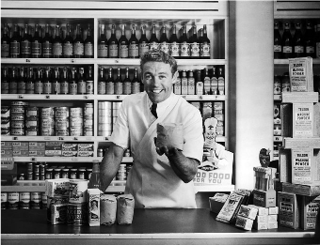
week 2: william morris, art nouveau + industrialization
+ Foundations and Tenets of the Arts and Crafts Movement
+ Rejection of Industrial Manufacturing Processes:
+ Rejection of mistakes of science-based approach of the 19th century
+ Creative labour: fulfilling "toil" through use of intellect, moral strengths, and physical powers
+ Use of traditional techniques, rather than mechanized processes
+ Artisan practices as a source of interest and pleasure
+ Emphasis on craft and labour-intensive techniques
+ Insert the mark of the maker, and the idiosyncratic approach
+ Result: fitting and beautiful
+ Develop a relationship between the producer and consumer
+ Return to a pastoral model of local economy/exchange (very relevant in 2023...)
+ Reaction against impersonal goods resulting from mass production

Slide 6
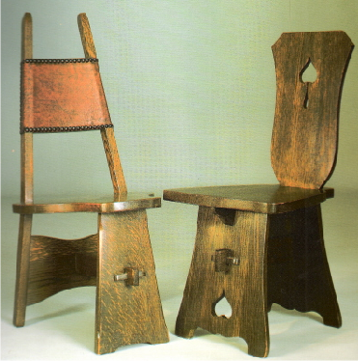
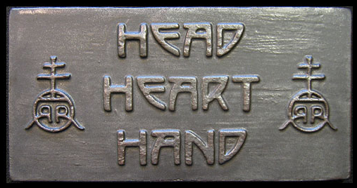
week 2: william morris, art nouveau + industrialization
+ Foundations and Tenets of the Arts and Crafts Movement
+ Raising the Visual Environment in Domestic/Everyday Life:
+ Belief in the beauty and utility of everyday life
+ Design for a middle-class clientele, not wealthy/elite
+ Spirituality/religiosity
+ Design could raise moral conscience of society
+ Transcendent quality to aesthetic: specifically
decoration and ornament
+ Head, heart, and hand
+ Elbert Hubbard/Roycroft Campus, East Aurora, NY
+ Industrial Production "Cheapens Goods":
+ Defiant rejection of standardization: never perfect or
"over-finished"
+ Reveled in traditional styles, as opposed to reductivist
minimalism, as a consequence of mass
production (simplification for machine-based
manufacture)

Slide 7
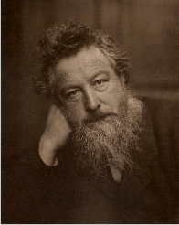
week 2: william morris, art nouveau + industrialization
+ William Morris: Background and History
+ "Have nothing in your house that you do not know to be useful, or believe to be beautiful."
+ Modern Renaissance Man:
+ Architect, printer, typographer, textile and furniture designer, poet, and theorist
+ Book design, calligraphy, furniture and decorative arts, paintings and drawings,
stained glass, tapestries, textiles, wallpapers, etc.
+ Important to understand and practice at all levels of the design
and production process
+ Against segregation of craft disciplines
+ Grandfather of Green Movement:
+ Retreat from the city
+ Dislike of the machine aesthetic
+ Morris believed it destroyed the possibility of self-expression, and
consequently, the possibility of art
+ Critic Roger Fry: "Whenever the machine enters, the nervous
tremour of the creator disappears."

Slide 8
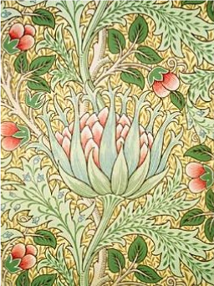
week 2: william morris, art nouveau + industrialization
+ William Morris: Aesthetics
+ Believed that Originality Elevates Life:
+ Discouraged replication or copying from the past
+ Innovation inspires; unoriginal goods reduce quality of life
+ Extolled the virtues of "taste" and "quality"
+ "Beauty is a marketable commodity, and...the better the work
is all around, both as a work of art
and in its technique, the more likely it is to find favour
with the public."
+ Unity:
+ Life as a means to art, not art as a part of life
+ Seriousness of commitment
+ Clive Bell Critique:
+ "...his mind could rarely escape from the place and age in
which it was formed."
+ Morris rejected progress for the sake of progress
+ Bell felt that Morris was detached from the realities of
contemporary life (utopian fantasy)

Slide 9
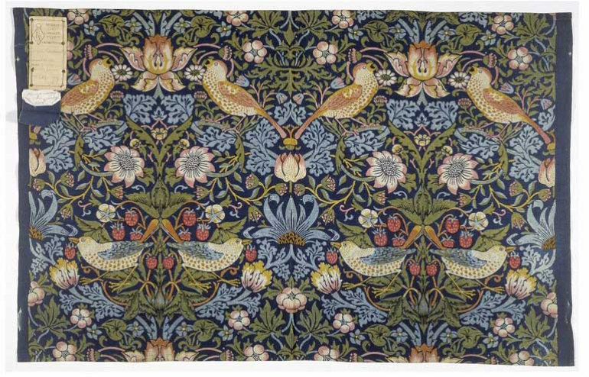
week 2: william morris, art nouveau + industrialization
+ William Morris: Strawberry Thief (1883)
+ Uses ancient and painstaking indigo-discharge: days to complete; one of his most popular patterns

Slide 10
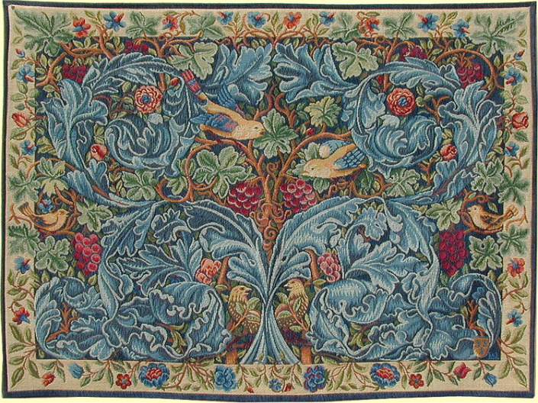
week 2: william morris, art nouveau + industrialization
+ William Morris: Acanthus and Vine Tapestry (1879)

Slide 11
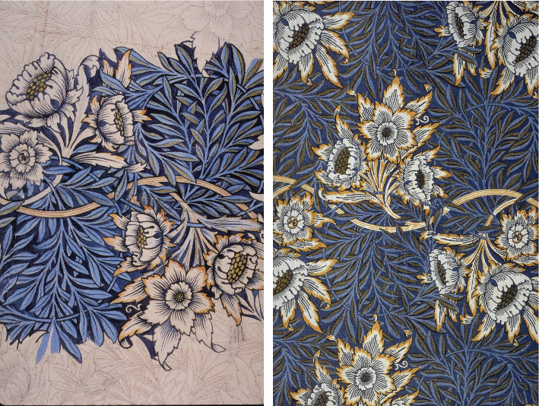
week 2: william morris, art nouveau + industrialization
+ William Morris: Sketch/Final Design for Tulip and Willow (1873)

Slide 12
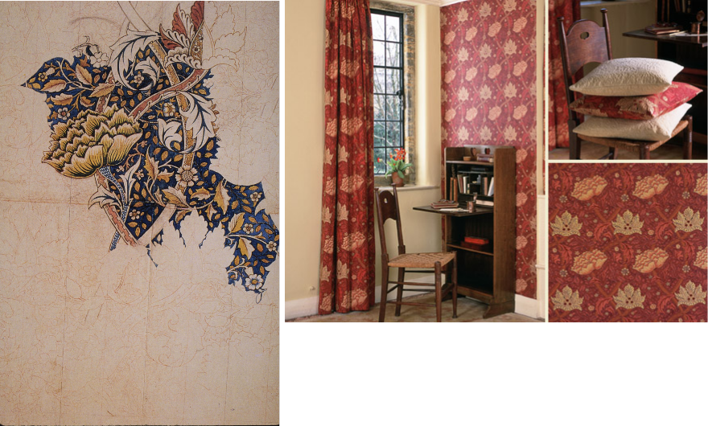
week 2: william morris, art nouveau + industrialization
+ William Morris: Design for Windrush (1881-1883)

Slide 13
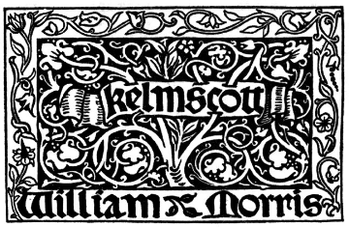
week 2: william morris, art nouveau + industrialization
+ William Morris: Kelmscott Press
+ 1891-1898:
+ Established press to focus on traditional printing and book-making techniques
+ Used 15th century methods as much as possible
+ Rejected new lithographic methods of mass production which attempted to simulate the look
of woodblock prints
+ Partially a response to Morris' growing interest in writing and social critique
+ Kelmscott Productions:
+ Morris designed 3 typefaces (Golden, Troy, Chaucer)
+ Designed floriated borders and initials for the books
+ Drew inspiration from incunabula (books pre-1501)
and their woodcut illustrations
+ Selection of paper, ink, and concerns for the overall
integration of type and decorations
+ Complete control over all aspects of design, layout,
craft and production - cohesive
+ In 7 years, the press produced more than 18,000
copies of 53 different works, comprising 69 volumes
+ Legacy:
+ Kelmscott Press was the most famous press of the Arts and Crafts movement
+ Main inspiration for what became known as the "Private Press Movement" and inspired the
revival of book arts

Slide 14
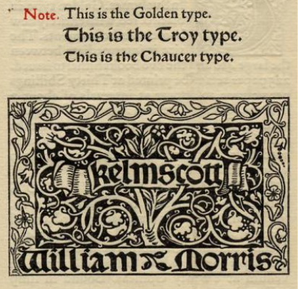
week 2: william morris, art nouveau + industrialization
+ William Morris: Kelmscott Press
+ Kelmscott Press Typefaces & Colophon (1897)
+ Based on fifteenth‐century models
+ Roman "Golden" type
+ Black letter "Troy" type
+ "Chaucer": revival of Troy
+ "I began printing books with the hope of producing some which would have a definite claim to
beauty, while at the same time they should be easy to read and should not dazzle the eye, or
trouble the intellect of the reader by eccentricity of form in the letters."

Slide 15
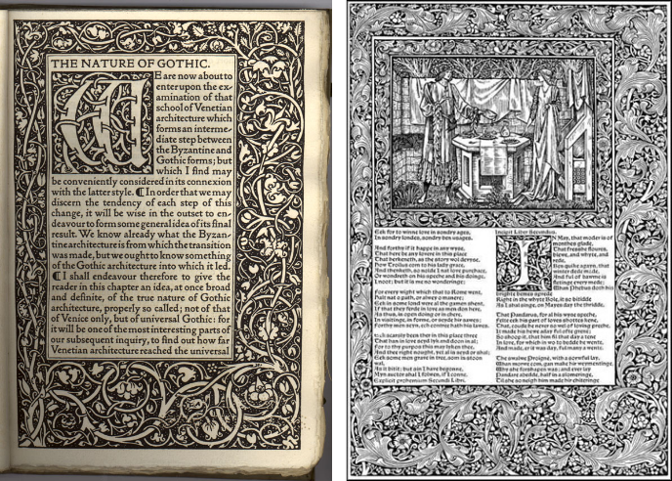
week 2: william morris, art nouveau + industrialization
+ William Morris: Kelmscott Press
+ The Nature of Gothic, John Ruskin (1853) + "Troilus and Criseyde," The Kelmscott Chaucer (1896)

Slide 16
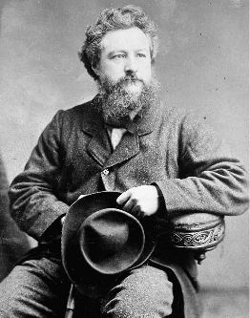
week 2: william morris, art nouveau + industrialization
+ William Morris: Socialism
+ He believed that we should judge culture by the amount of
freedom of expression allowed to individual workers
+ Difference between individuals based on their skills and
experiences
+ Rewarded for these differences/abilities
+ Socialism cannot be achieved by the actions of individuals
+ Belief that art can only flourish if capitalism disappears
+ "...art cannot have real life and growth under the present
system of commercialism and profit mongering."
+ Idealism: purpose before profit, education before consumption
+ Art as a "holy war against the age"
+ Founded on transformation of a way of living
+ "Art and Socialism" lecture (Leicester Secular Society 1884):
+ Marxist historian A. L. Morton: "Art and Socialism's outstanding
feature is perhaps the stress laid on work as a necessity of
human life, not merely as a means of obtaining a livelihood.
Morris insists that only Socialism can restore work to its
proper, central position."

Slide 17
week 2: william morris, art nouveau + industrialization
+ William Morris: "The Voice of Toil," Chants for Socialists (1915)
I heard men saying, Leave hope and praying,
All days shall be as all have been;
To-day and to-morrow bring fear and sorrow,
The never-ending toil between.
When Earth was younger mid toil and hunger,
In hope we strove, and our hands were strong;
Then great men led us, with words they fed us,
And bade us right the earthly wrong.
Go read in story their deeds and glory,
Their names amidst the nameless dead;
Turn then from lying to us slow-dying
In that good world to which they led;
Where fast and faster our iron master,
The thing we made, for ever drives,
Bids us grind treasure and fashion pleasure
For other hopes and other lives.
Where home is a hovel and dull we grovel,
Forgetting that the world is fair;
Where no babe we cherish, lest its very soul perish;
Where our mirth is crime, our love a snare.
Who now shall lead us, what god shall heed us
As we lie in the hell our hands have won?
For us are no rulers but fools and befoolers,
The great are fallen, the wise men gone.
I heard men saying, Leave tears and praying,
The sharp knife heedeth not the sheep;
Are we not stronger than the rich and the wronger,
When day breaks over dreams and sleep?
Come, shoulder to shoulder ere the world grows older!
Help lies in nought but thee and me;
Hope is before us, the long years that bore us
Bore leaders more than men may be.
Let dead hearts tarry and trade and marry,
And trembling nurse their dreams of mirth,
While we the living our lives are giving
To bring the bright new world to birth.
Come, shoulder to shoulder ere earth grows older
The Cause spreads over land and sea;
Now the world shaketh, and fear awaketh
And joy at last for thee and me.

Slide 18
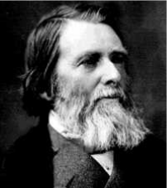
week 2: william morris, art nouveau + industrialization
+ Influence of John Ruskin
+ Critic, Socialist: produced influential essays on art and architecture
+ Declared that it was not possible to be a rich socialist
+ Believed art communicated an understanding of nature
+ True artists reject conventions/contrivances and derive aesthetic
sensibility through direct observation and study
+ Art communicated truth: expression of moral beliefs of the artist
+ Strength, solidarity, aspiration
+ Rejection of mechanization and standardization
+ Relationship between worker/guild, worker/community,
worker/nature, worker/God
+ Demoralizing effects of the Industrial Revolution
+ The Nature of Gothic (1853): "...the liberty of every workman...a freedom of thought, and rank in
scale of being, such as no laws, no charters, no charities can secure."
+ Attacked Capitalism: failed to acknowledge human desires and motivations
+ Jobs should be paid at fixed rates: best workers are employed, not those offering to do so at the
cheapest price
+ "Nay, but I choose my physician and my clergyman, thus indicating my sense of the quality of
their work. By all means also, choose your bricklayer; that is the proper reward of the good
workman, to be 'chosen.'"
+ Workers being used as tools, not as people

Slide 19
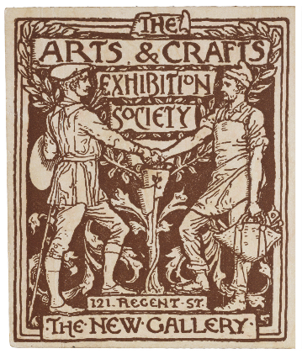
week 2: william morris, art nouveau + industrialization
+ The Paradox of Everyday Design (A Critique)
+ Art and Crafts Production:
+ Time-consuming, labourious
+ Competing with cheaper, industrial products
+ More expensive, due to effort, materials, processes,
and limited production volume
+ Charge premium prices
+ Paradox:
+ Designing for the "everyman," in order to overcome
the pressure of life resulting from industrialization
+ Advocated "buying goods at due price."
+ Not affordable to the intended audience
+ Middle-class and wealthy primary clientelle
+ Elitist? Out of touch with societal conditions?
+ Didactic ("educating" the public)?
+ Questions/discussion topics
+ Cultural cachet of Socialism?
+ Value of aesthetics to typical urban factory worker?
+ Philosophical expression, or valid alternative?
+ Well-known designers working for Target? H&M?
+ Moral/ethical values of Dollarama?

Slide 20
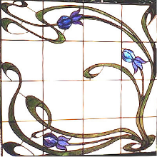
week 2: william morris, art nouveau + industrialization
+ Art Nouveau: An Overview
+ Arts and Crafts Movement Leads to Art Nouveau:
+ Looking back at history as inspiration, but adapting to a more
Modern sensibility
+ 1880s to pre-WWI: "The New Art":
+ Inspiration from wild/unruly aspects of natural world
+ Influence of Darwin (1859): humans no longer above nature
+ Themes: metamorphosis, hybridity, fusion
+ Primarily influenced applied arts, graphics, illustration
+ Iconic qualities: sinuous lines and "whiplash" curves
+ Derived and inspired by Victorian botanical studies
+ Flowing line is a metaphor for freedom and release from
the weight of artistic tradition and critical expectations
+ Seeking to break away from past styles
+ Outgrowth from Arts and Crafts and Aesthetic Movements:
+ Seeking reform through art
+ Advocated for unity of the arts: against segregation between fine arts (painting, sculpture, etc.)
and the "lesser" decorative arts
+ Attempted to synthesize art and craft through Gesamtkunstwerk ("total work of art”, Wagner)
+ Often seen in the works of architects: design all elements of interior/exterior/utility
+ Victor Horta, Henry van de Velde, Josef Hoffman, etc.

Slide 21
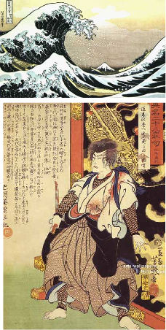
week 2: william morris, art nouveau + industrialization
+ Art Nouveau: Cultural Influences
+ Primarily Centered in France:
+ Developed in other areas of Europe
+ Style nouille/Style coup de fouet (Belgium); Jugendstil/"young style"
(Germany); Modernista (Barcelona), etc.
+ Spread to the United States
+ "Tiffany Style": Louis Comfort Tiffany
+ Global Influences:
+ Urban style, decorating industrial cities
+ Exotic themes: Asian and Islamic arts
+ Japanese Arts: especially Ukiyo-e prints ("floating world")
+ Termed "Japonisme" in 1850s-1860s
+ Result of trade expansion in Japan (Commodore Perry)
+ Legacy of Art Nouveau:
+ International in scope, but short‐lived
+ Precursor of Modernism: elimination of superfluous ornament
+ Influenced Art Deco designs
+ Art Nouveau-inspired graphics became popular again in 1960s:
social and political turbulence
+ Gained favour with a new generation challenging conventional
taste and ideas

Slide 22
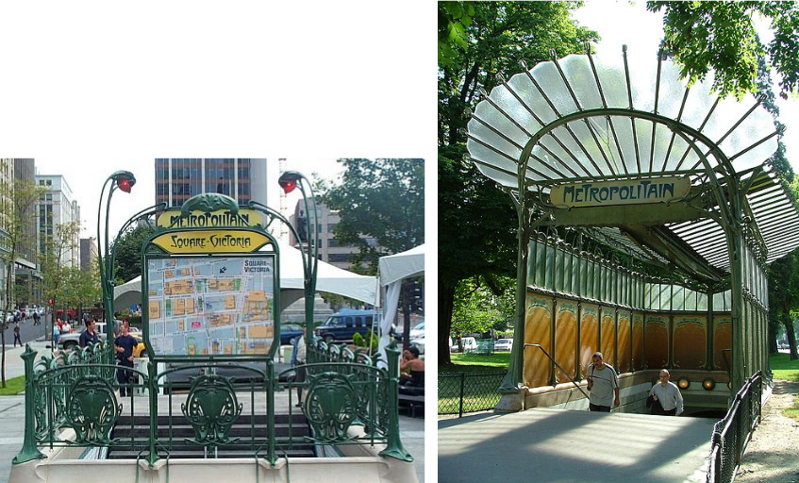
week 2: william morris, art nouveau + industrialization
+ Hector Guimard, Entrance to the Métropolitan (1899)
+ Manufactured in prefabricated sections
+ Permit different configurations for different
locations
+ Influence of industrial technologies, combined
with natural aesthetics
+ Use of cast iron and industrial sheet glass
+ Symbol of modernity and strength
+ "Guillmard style" or "Style Métro"

Slide 23
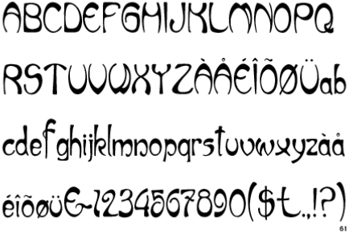
week 2: william morris, art nouveau + industrialization
+ The Politics of Ornament
+ Decoration was seen as an expression of emotion
+ Key aesthetic approach that ties together the disparate practices of Art Nouveau practitioners
+ Means of courting wealthy patrons, radical/liberal educated classes, and the socially aspiring
+ Seen as a modern, urban style
+ Relation to today: green conscience, ethical/fair trade, organic (luxury premium)
+ Early Modernists saw art as a spiritual matter and movements as crusades with implications wider
than the aesthetic domain
+ Reformist zeal/mysticism

Slide 24
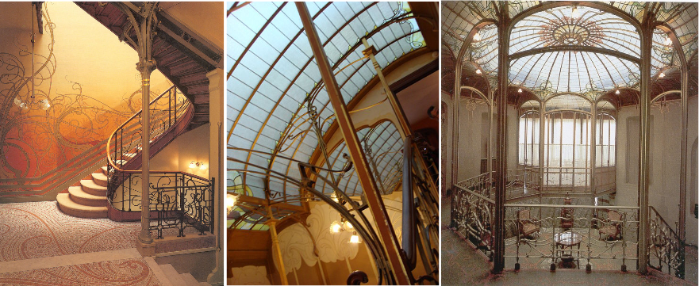
week 2: william morris, art nouveau + industrialization
+ Victor Horta (Belgian)
+ Key architect of European Art Nouveau
+ Hôtel Tassel, Brussels (1892-3)

Slide 25
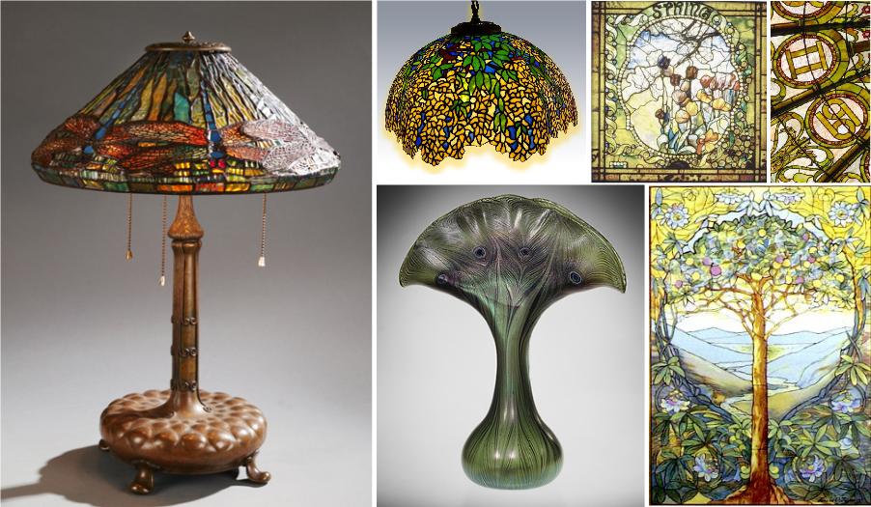
week 2: william morris, art nouveau + industrialization
+ Louis Comfort Tiffany (American)

Slide 26
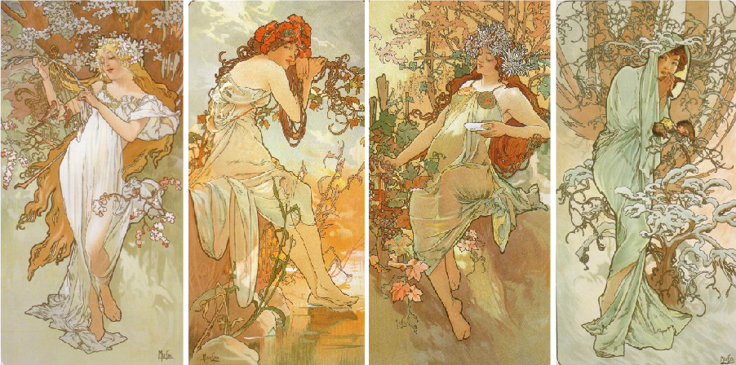
week 2: william morris, art nouveau + industrialization
+ Alfons Mucha (Czech)
+ The Seasons (1896)

Slide 27
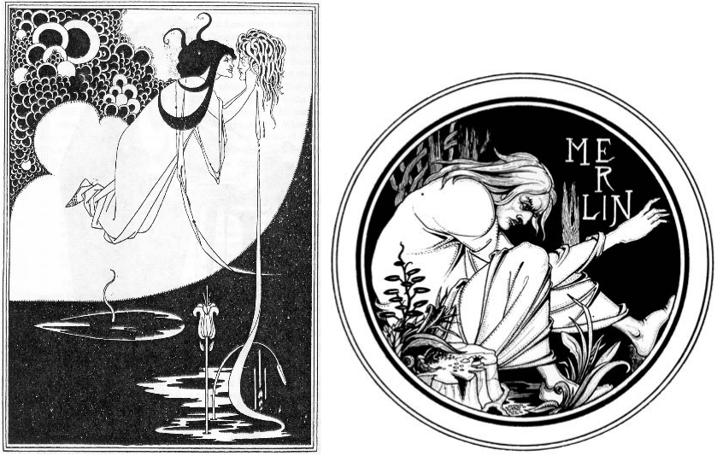
week 2: william morris, art nouveau + industrialization
+ Aubrey Beardsley (English)
+ J'ai baisé ta bouche Jokanaan (1894)
From Oscar Wilde's Salomé

Slide 28
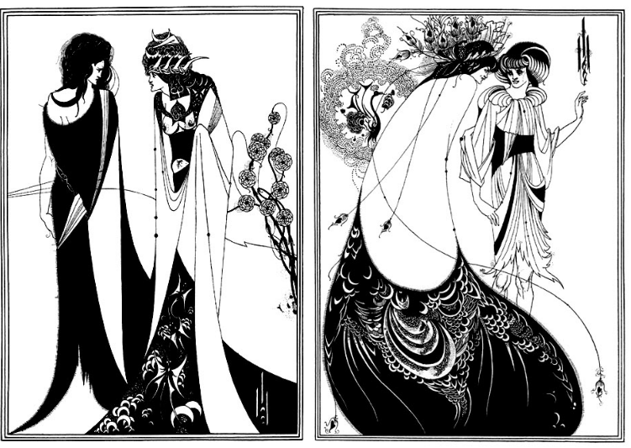
week 2: william morris, art nouveau + industrialization
+ Aubrey Beardsley (English)

Slide 29
week 2: william morris, art nouveau + industrialization
+ Reflective Summaries (15% - 5% each; due Sept. 26, Oct. 24, Nov. 14)
+ Based on readings from previous two weeks (1-3 / 4-6 / 7-9)
+ Select one reading/website/film on which to focus
+ Select an everyday artifact/object/ritual/graphic image to illustrate (or contradict) one of the main
concepts of the chosen reference
+ May be contemporary or from a previous era (CANNOT be an example referred to in article or class presentation)
+ Relate the artifact to the article, including the following:
+ An overview of the specific qualities, characteristics, and connotations that connect it to
the reading/resource
+ A summary of how the artifact relates to the general themes of the lecture on that week
+ An indication of key historical and political influences from the era of the artifact’s production
+ A statement on how it activates/reflects the culture of its time and place
+ Format: approximately 500 words, PDF format
+ Include: title, name, id, course, date, name of artifact
+ Include a photograph of the selected artifact
+ Upload digital copy to Moodle

Slide 30
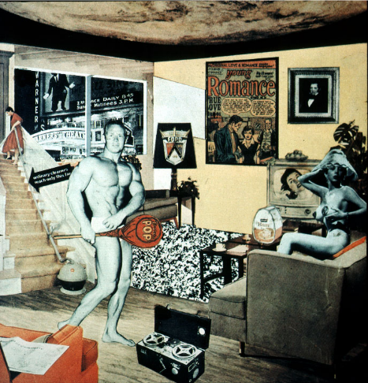
week 2: william morris, art nouveau + industrialization
+ Major Assignment: "Just What is it That Makes Today’s Homes So Different, So Appealing?”
+ Part 1: Research (30%, due October 31)
+ Part 2: Integration (40%, due November 28)
+ Richard Hamilton (1956)

Slide 31
week 2: william morris, art nouveau + industrialization
+ Major Assignment: "Just What is it That Makes Today’s Homes So Different, So Appealing?”
+ Overview:
+ Commit to a specific artifact, live with it, document your interactions/environment/context of use
+ Can be almost anything (shampoo, coffee cup, typeface, etc.) - be specific!
+ Collection of information, texts, photographs that help you to better understand the life and story
of your artifact
+ Determine how it influences, and is influenced by the culture/world in which it operates
+ Will be the subject of your entire semester of research--choose carefully!
+ Part 1: Research (30%, due October 31)
+ Anthropological field study
+ Section 1:
+ Explain your choice; personal resonance/significance
+ Describe its physical characteristics; 10 captioned photos, brief text
+ Detailed description of its contextual environments; 5 captioned in-situ photos, brief text
+ Capture within its natural environment
+ Section 2:
+ 10 captioned images of different but comparable products; same codes/cultural signals and
connotations (cannot be different brands of same artifact type)
+ Choose 4 photos to elaborate on how each expands your understanding of the original artifact
+ Section 3:
+ Summary/Conclusions
+ Format:
+ PDF presentation
+ 25 captioned photos; approximately 750 words (not including captions)

Slide 32
week 2: william morris, art nouveau + industrialization
+ Heads-Up:
+ Tutorial Today
+ Arts and Crafts discussion
+ Video screening: Thank You for the Music, Dir. Mika Taanila (20:00)
+ Trailer
+ Questions regarding course/assignments/article summaries
+ Readings + Websites (ONE Of):
+ Smith, Adam. Excerpts from An Inquiry into the Nature and Causes of the Wealth of Nations.
(Chapters 1-4)
+ Taylor, Frederick Winslow. “Fundamentals of Scientific Management.” The Principles of Scientific
Management. (Chapter 1)

