Slide 1
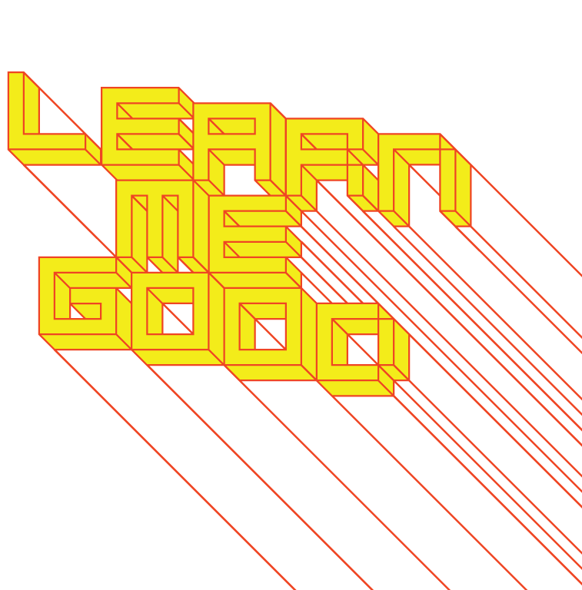
WEEK 2

Slide 2
week 2: design 1:1 – human scale, capacity, and amplification
+ Class Schedule:
+ Thought Experiments (~30:00)
+ Presentation
+ Scale, technological extensions of biological limitations
+ Perception and time
+ Human-centered design

Slide 3
week 2: design 1:1 – human scale, capacity, and amplification
+ Thought Experiments – Scenario:
+ Maureen is a 28-year-old dental school intern who has recently been diagnosed with type 1 diabetes.
Adapting to her new routine of insulin injections and blood sugar monitoring has been difficult. Her
job and studies require a good amount of mental concentration, which means that she is often
unaware of the present time. Coupled with lengthy, back-to-back internship appointments and
studies, she has frequently missed important injections and blood tests.
Your task is to design a system/device/application/etc. that will aid Maureen in monitoring her
health conditions. First, list all the contextual considerations to bear in mind when designing for
this specific client. You may consider physical, digital, graphical or systemic solutions, but they
must respect and fit into her lifestyle and professional practice.
Survey existing systems/solutions and try to develop something that builds on and differs from these. Feel free to be as speculative and inventive as you wish.
+ Upload your response to the Moodle forum
+ One post per team
+ Be sure to include the names of all team members

Slide 4
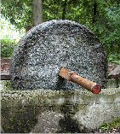
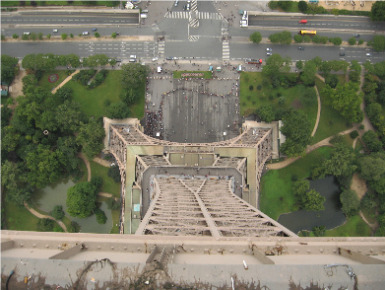
week 2: design 1:1 – human scale, capacity, and amplification
+ Tools and Progress
+ Progress is traditionally equated with the history of speed
+ Humans design and build things to augment our
physiological/biological limitations (tool builders)
+ Amplification
+ Transgressing the laws of physics (space, time, matter)
+ It is no longer remarkable that we can rise above the treetops
+ Eiffel Tower (Gustave Eiffel,1889)
+ Tallest structure in the world until the Chrysler
Building surpassed it 41 years later
+ Controversial structure; seen as a blight on the city
+ A marvel of technology and a central icon of the
industrial revolution
+ Completely changed human perspective
(and perceptions) of the world
+ Skyscrapers have continued to soar becoming
demonstrations of power and wealth
+ Conquering the natural world through built
(human) structures
+ One need only to look to the artificial
archipelago in Dubai (The World Islands)

Slide 5
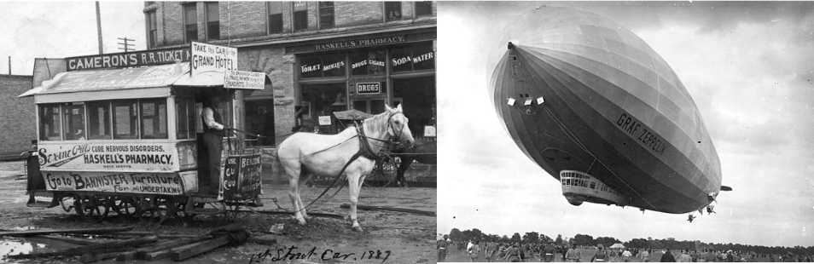
week 2: design 1:1 – human scale, capacity, and amplification
+ Distance and Transportation
+ We have developed many means to overcome long distances of travel
+ Finite capacities: there is only so much a human can accomplish without exhaustion
+ Developments increase our muscle abilities/endurance, allowing us to carry more through
construction of rigid, durable structures
+ Augments and expands our ability to achieve greater speeds: we can go further, faster
+ Horse cart >> carriages >> cars >> zeppelins >> airplanes >> boats >> space craft >> etc.
+ Subways >> elevators >> escalators >> STAIRS!

Slide 6
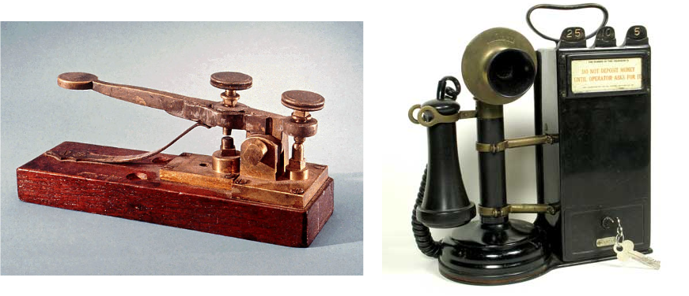
week 2: design 1:1 – human scale, capacity, and amplification
+ Media/Communications
+ Space and TIME are subverted (the laws of physics rewritten)
+ The radio, telegraph and telephone allow(ed) humans to speak over great distances
+ One can only yell so loud!
+ Television, film, and now the Internet, create further separations from a humanistic sense of time
+ The notion of "real-time" has come to mean something very different today
+ The Internet has amplified notions of speed to incomprehensible levels

Slide 7
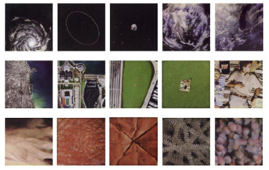
week 2: design 1:1 – human scale, capacity, and amplification
+ Becoming Cyborgs
+ Humans are not just augmenting the built environment, but are becoming cyborgs
+ We are physically changing the nature of our biology by developing hybrid artifacts
+ Contact lenses >> hearing aids >> artificial limbs >> nanotechnology >> etc.
+ We are using technology to restructure our chemistry, brain, and cellular structure
+ Pharmaceuticals >> surgical procedures >> modifications >> genetics >> ???
+ This is not INHERENTLY bad, however...
+ This calls into question our relationships to the natural world, our bodies, our social
structures (among other ethical considerations)
+ Nature (including humankind) is amazingly adaptable and resilient, but we are rapidly
approaching the limits of sustainability
+ Stelarc
+ We are living in a world where we are already
POST-HUMAN
+ Think back to Baudrillard's notion of hyperreality
+ Charles and Ray Eames, "Powers of Ten" (1968)
+ Macrocosm and microcosm

Slide 8
week 2: design 1:1 – human scale, capacity, and amplification
+ Paola Antonelli, Design and the Elastic Mind
+ As Antonelli notes, our notions of distance and time have shifted radically since 1968
+ "Design 1:1" embraces a return to simplicity, in all its permutations
+ Examine the visible world, as opposed to fetishizing the non-human and invisible
+ "Indeed, WHERE and WHEN have become difficult to pin down on any WHO. There is a
standoff between the two ancient Greek notions of time: CHRONOS, the shared convention
of sequential time marked by the sundial, and KAIROS, the subjective moment that allows
an individual to adapt and evolve with circumstances."
+ The latter has us furtively clinging on to personal moments and records (social media, Instagram,
Tweets, TikToks, etc.)
+ We have lost the notion of "real-time"
+ The baseline for understanding what it means to exist in our bodies and in our
environment has diminished
+ We have disconnected from out "meat bodies"
+ An experiment in perception...
+ 60 seconds of deprivation

Slide 9
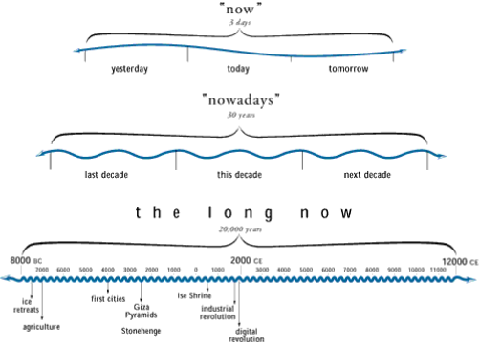
week 2: design 1:1 – human scale, capacity, and amplification
+ Danny Hillis
+ The Long Now Foundation and Deep Time
+ "When I was a child, people used
to talk about what would happen by
the year 2000. For the next thirty
years they kept talking about
what would happen by the year
2000, and now no one mentions
a future date at all. The future
has been shrinking by one year
per year for my entire life.
I think it is time for us to start
a long-term project that gets
people thinking past the mental
barrier of an ever-shortening
future. I would like to propose a
large (think Stonehenge)
mechanical clock, powered
by seasonal temperature changes.
It ticks once a year, bongs once a century,
and the cuckoo comes out every millennium."
+ The 10,000 Year Clock
+ Brian Eno: 3.5 million unique bell chime sequences — one for every day the clock is visited for the next 10,000 years

Slide 10
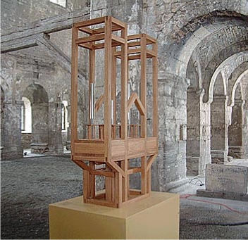
week 2: design 1:1 – human scale, capacity, and amplification
+ John Cage
+ As SLow aS Possible
+ Composition and dates
+ Documentation of note change
+ St. Burchardi Cathedral, Halberstadt
+ The first organ with a modern keyboard arrangement, built in 1361 (639 years
before 2000)
+ Began on September 5, 2001, with 17 months of silence
+ The performance will last 639 years,
changing notes roughly once a year
+ Subverting contemporary notions of what
being "human" is about
+ Can never be heard in its entirety

Slide 11
week 2: design 1:1 – human scale, capacity, and amplification
+ Human-Centered Design
+ Design and the Elastic Mind, MoMA (2008)
+ "If design is to help enable us to live to the fullest while taking advantage of all the
possibilities provided by contemporary technology, designers need to make both people
and objects perfectly elastic. ... [Many design schools increasingly] focus their courses on
senses and sensuality, identity, memory, and on other staples of humankind - birth, death,
love, safety, and curiosity - yet are rendered urgent by the speed with which technology is
moving." - Paola Antonelli, "Design 1:1"
+ "These principles differ from the so-called human-centered design that functionalist
industrial designers of the past fifty years have employed to shift their attention from the
object to the "user"; they are reminders of the great responsibility that comes with design's
new great power of giving form and meaning to the degrees of freedom opened by the
progress of technology." - Paola Antonelli, "Design 1:1"
+ Let's Be Human Beings
+ Focus on genuine human concerns, develop empathy
+ Develop a stronger sensorial awareness and spectrum
+ Design "emotionally durable" artifacts (Jonathan Chapman)

Slide 12

week 2: design 1:1 – human scale, capacity, and amplification
+ Human-Centered Design
+ The Power of Design Research
+ Responding to the specific needs, challenges, and scenarios of ACTUAL HUMANS, not
"users" and demographics
+ Performing field studies with participants, rather than imposing a universalist
approach to process methodology
+ Design for: people >> individuals >> customized experiences
+ Frog Design
+ IDEO
+ TED Talk: David Kelly, IDEO (~20:00)
+ Objectified (IDEO segment; ~5:00, begins at 59:30)

Slide 13
week 2: design 1:1 – human scale, capacity, and amplification
+ Assignment: Je me souviens (Part 1 due February 17; 20%)
+ Montreal as a UNESCO City of Design
+ What makes a "design city"?
+ Select an example of what you feel to be well-designed
+ Architecture, public parks, systems, street furniture, infrastructure, etc.
+ MUST be Montreal-specific
+ "Even the city itself acknowledges that ‘design in Montreal is not simply for show but a source of
daily wellbeing.’ Not only has Montreal demonstrated that design can be a powerful tool in
promoting inclusion and plurality of values, but the city has also called upon its citizens to play a
critical and active part in mobilizing design to inspire more innovative living environments that
enhance daily life and existence.” - Koichiro Matsuura (UNESCO Director-General)
+ Not just a celebration of Montreal's attributes
+ The second part of the assignment will address the less effective elements of the city
+ Think about inhabitation: how do these artifacts/experiences shape the daily life of citizens (for
better or for worse)?
+ Use the issues, frameworks, guiding principles explored in class
+ What contextual, semantic, and physical concerns need to be addressed/investigated?
+ Examine the patterns of use, appropriateness of material choices, and general mood/atmosphere
+ Is it workable/livable/enjoyable?
+ Does it make a positive contribution to the everyday experience?

Slide 14
week 2: design 1:1 – human scale, capacity, and amplification
+ Assignment: Je me souviens (Part 1 due February 17; 20%)
+ Suggested Framework
+ Section I: Observation (500 words):
+ Ia: Briefly explain your choice; identify date/name of designer (if known); succinctly state its major
positive attributes (100 words)
+ Ib: Provide a brief history of your artifact/space, including key dates/transitions (100 words)
+ Ic: Provide a description of its visual and physical characteristics; include a map denoting its location
in the city (150 words, plus 10 photos/captions)
+ Id: Include a detailed description of its contextual environment (150 words); consider
+ Surfaces: hard/soft; changing/static
+ Size or volume: interior/exterior; confined/walled/open; reverb/echo/flat
+ Variety: balance of natural/human/manufactured phenomena; contrasts/similarities
+ Qualities: loud/quiet; harsh/sharp/soft/gentle
+ Layers: multiple simultaneous/discrete; easily-distinguished/seamless blend
+ Make sure that your photographs reveal different facets of the artifact
+ Verify that you are able to photograph in-situ (i.e. not private property)

Slide 15
week 2: design 1:1 – human scale, capacity, and amplification
+ Assignment: Je me souviens (Part 1 due February 20; 20%)
+ Section II: Occupation (500 words)
+ IIa: How does the general public interact with your artifact? Who, how, when, and under what
circumstances? Does this change during the day or seasons? Is it available to all, or restricted to a
specific demographic? (250 words)
+ IIb: Consider the functionality of your artifact (perceived/purported practical functions). Is there a
discrepancy between this and the experience of the user? Can this be quantified? (250 words)
+ Section III: Analysis (500 words)
+ IIIa: Apply principles studied in DART 261/262 to justify your assessment
+ As a starting point, consider Dieter Rams' Ten Principles for Good Design
+ Consider durability of your artifact: both physical and emotional
+ Is your artifact healthy: physically, environmentally, socially?
+ Does it help the public in positive ways (not mere ornamentation)?
+ Is it responsive to human scale? Does it evoke a positive sentiment?
+ You must integrate a minimum of 3 sources from the course or elsewhere
+ Section IV: Conclusion (100 words)
+ Succinctly describe your reasoning for the positive assessment
+ How does it activate and reflect the culture of its time and place?
+ If your artifact is historical, how does it function today?

Slide 16
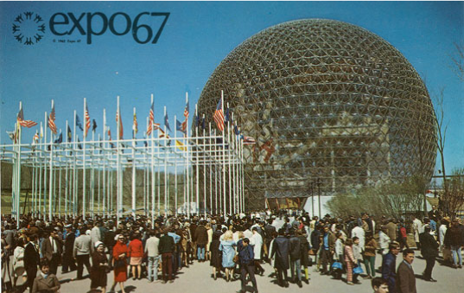
week 2: design 1:1 – human scale, capacity, and amplification
+ Assignment: Je me souviens (Part 1 due February 17; 20%)
+ Deliverables:
+ Complete ALL 4 SECTIONS for the due date
+ Approximate length: 1600 words, plus captions (PDF FORMAT ONLY)
+ Photographs and captions should be integrated into the body of the text
+ Upload to Moodle

Slide 17
week 2: design 1:1 – human scale, capacity, and amplification
+ Tutorial
+ By reflecting on your own experience about your current location, try to come up with an object (it
can be a building, a piece of urban furniture, a crack in the pavement, a natural landscape...) that
helps you to situate yourself in space, that gives a sense of scale to your environment. Think about
repetition, materiality, colours, dimensions, shadows, speed, forms, etc.
+ Example 1: bricks as tangible objects that construct massive architectural forms
+ Example 2: 10-year passport photos
+ Write a 1-2 paragraph text explaining your choice
+ Create a quick sketch to accompany your text
+ Post your response to Moodle

Slide 18
week 2: design 1:1 – human scale, capacity, and amplification
+ Ready, Set, Go!
+ For Next Week:
+ Read: Dunne, Anthony and Fiona Raby. Design Noir: The Secret Life of
Electronic Objects (pages 58-63; PDF/Library Reserves)
+ Read: Fuad-Luke, Alastair. “Reflection, Consciousness, Progress: Creatively
Slow Designing the Present” (external link)
+ Visit website: “About” DROOG
+ Visit website: “Projects.” Dunne & Raby
+ Post Summary from Play Session to Moodle
+ Post Tutorial Activity to Moodle

