Slide 1
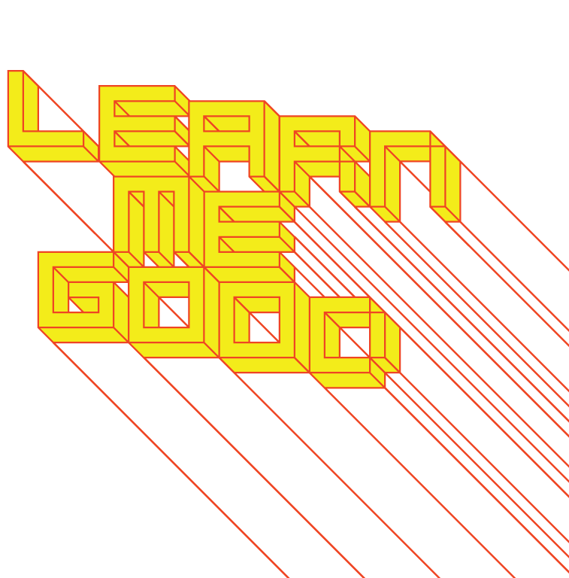
WEEK 3

Slide 2
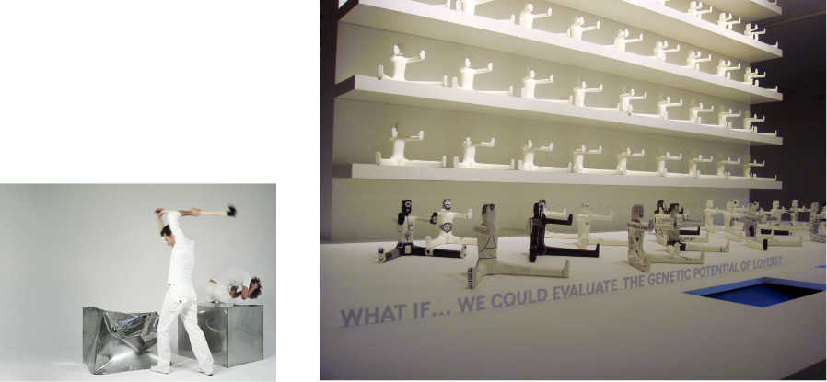
week 3: affirmative vs. critical design / fast vs. slow knowledge
+ Class Schedule:
+ Design for Debate:
+ Dunne & Raby
+ DROOG
+ Thought Experiments

Slide 3
week 3: affirmative vs. critical design / fast vs. slow knowledge
+ Thought Experiments (~30 Minutes)
+ John is a 35-year-old lawyer who recently passed the bar exam and is also the father of a newborn
baby girl. As one half of a professional couple, John splits the responsibility of raising his child,
picking her up from the nanny’s house during the middle of the afternoon. In order to do so, John
needs to carry a diaper bag containing the necessary supplies along with his laptop and papers,
while still maintaining a professional image.
+ What factors need to be considered in designing a new, appropriate bag for John? How might
you go about developing a serviceable item to meet John’s complex needs?
+ Carla is a 76-year-old retired nurse living 1200 kilometres from her closest relatives. She wants to
keep in touch with her four grandchildren, and also has concerns about her failing health and living
alone. She owns a cell phone for protection and emergency situations, but has found the
miniaturized interface too small to function properly, given her severely arthritic hands and declining
eyesight.
+ How would you go about developing an alternative system to accommodate the needs of an
aging population?
+ Jack is a 26-year-old fast food line cook who is looking to pursue a business degree. As a mature
student with average high school grades, he is concerned about his ability to succeed academically
and socially in an institute of higher learning. He is also concerned about finances, as he will be
taking out student loans and cashing in his savings to afford this professional program.
+ As a designer, what considerations would you need to address in preparing a marketing
campaign targeted at a similar demographic? What graphical approaches, aesthetics, and
language would you employ to connect with Jack?

Slide 4
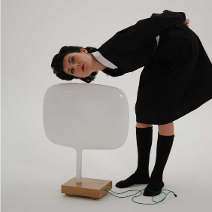
week 3: affirmative vs. critical design / fast vs. slow knowledge
+ Design is Ideological (Anthony Dunne)
+ Rapid technological progress demands critical reflection (more than ever!)
+ We should consider developing a parallel practice that questions and challenges industrial agendas
+ "... all design is ideological, the design process is informed by values based on a specific world
view, or way of seeing and understanding reality."
+ Affirmative vs. Critical Design:
+ Affirmative: "... reinforces how things are now, it conforms to cultural, social, technical and
economic expectations."
+ Most design falls into this category (the archetypes)
+ Critical: "... rejects how things are now as being the only possibility, it provides a critique of the
prevailing situation through designs that embody alternative social, cultural, technical or
economic values."
+ This is one reason for our "thought experiments"
+ Objectified (Dunne & Raby segment, ~5:00, start at 1:05:45)
+ Dunne & Raby (Website)
+ Technological Dream Series: No. 1, Robots (~5:00)
+ Designs for an Overpopulated Planet: No. 1, Foragers (~3:00)

Slide 5
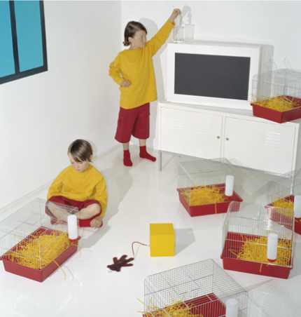
week 3: affirmative vs. critical design / fast vs. slow knowledge
+ Critical Design
+ Distinction from Art?
+ Too far removed from the world of mass consumption
+ Push the cultural and aesthetic potential of objects
+ Affirmative Design:
+ Main purpose is to provide new products
+ Smaller, faster, different, better
+ What do we actually need?
+ How can poetic moments be intertwined in everyday life?
+ Purpose of Critical/Speculative Design:
+ "Critical design is related to haute couture, concept cars,
design propaganda, and visions of the future, but its
purpose is not to present the dreams of industry, attract
new business, anticipate new trends or test the market.
Its purpose is to stimulate discussion and debate amongst
designers, industry and the public about the aesthetic
quality of our electronically mediated existence."

Slide 6
week 3: affirmative vs. critical design / fast vs. slow knowledge
+ Critical Design
+ Distinction from Experimental Design?
+ Not about extending the medium in the name of progress and aesthetic novelty
+ "Critical design takes as its medium social, psychological, cultural, technical and economic
values, in an effort to push the limits of lived experience not the medium."
+ Difficulties of Implementation:
+ The design discipline is inherently related to the marketplace
+ Designing outside this system appears to be escapist or unrealistic
+ Often seen as merely a P.R. strategy to sell "innovation" (this critique has been levied on IDEO)
+ Objects critical of industrial practices are unlikely to be supported (viewed as mocking, trivial, etc.)
+ Critical design is less marketable, as it doesn't generate significant capital gain
+ Why is it Important?
+ Keep industry in-check through self-regulation
+ Advocate for importance and legitimacy of the profession
+ Lose intellectual credibility if we are reduced to merely reinforcing capitalist desires
+ Take on a more proactive, responsible role in society
+ "Corporations have a bigger influence on reality than government, and buying power is more
important than voting power. A world where shopping has more political impact than voting is
a threat to democracy."
+ Relations between popular culture, market and critical positions have changed
+ Design is perfectly positioned between these 3 axes
+ It keeps designers (and the industry) vital, innovative, and interesting

Slide 7
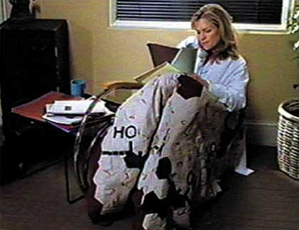
week 3: affirmative vs. critical design / fast vs. slow knowledge
+ Case Study: Mel Chin, GALA Committee/In the Name of the Place (1996)
+ Use of television as a subversive medium
+ Offered producers of Melrose Place free art/design/styling for the set
+ Established a committee of students (U. of Georgia/CalArts)
+ Non-commercial PIMs (Product Insertion Manifestations)
+ Attempt to deal with serious issues that are typically trivialized by TV
+ Gender issues, violence, infectious diseases
+ Depict scenes of infamous LA locations of violence (Rodney King, Marilyn Monroe,
Nicole Brown Simpson)
+ Lots of sex on M.P. but no use of condoms >> created bed linens covered in unrolled condoms
+ "Viruses are self-replicating, but they mutate, and
to me, that’s like an art idea. I was wondering,
how do you get an idea into a system, and let it
replicate within that system?"
+ In the Name of the Place. RU 486 Quilt

Slide 8
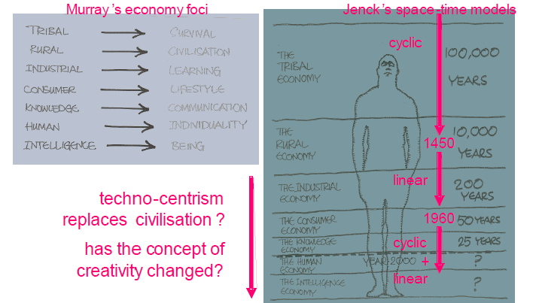
week 3: affirmative vs. critical design / fast vs. slow knowledge
+ Fast Knowledge vs. Slow Knowledge (Alastair Fuad-Luke)
+ Without "ifs" in the design practice, the status quo is maintained
+ Embedded within the theory/practice connection (indistinguishable from one another)
+ Gui Bonsieppe: "... critical thinking – is rooted in the domain of social discourse and thus, in the
final instance, in that of politics, where the question is: In what sort of a society do members of
that society wish to live?"
+ If + (human, social, natural, financial, manufactured capitals) = creativity
+ Will Murray, brand consultant
+ Charles Jencks, architectural critic

Slide 9

week 3: affirmative vs. critical design / fast vs. slow knowledge
+ Fast Knowledge vs. Slow Knowledge (Alastair Fuad-Luke)
+ Historical Trajectory:
+ Emerging human/intelligence economies >> tend to focus more on individuality and "being"
+ Ever-shortening lifespan of each type of economy since the industrial revolution
+ 1450: paradigm shift from cyclical time to linear space-time
+ In the postmodern era, these ideas converged/collapsed (chronos/kairos)
+ We have developed an "always on" sensibility
+ Embedded techno-centrism
+ Actual physical change has accelerated (resource flows, etc.), as well as perception of
rate of change
+ Unsustainable Time:
+ If all global citizens conformed to the UK's GDP/resource use: "8 planets of energy (CO²); 8
planets of aluminum; 3 planets of cement; 3½ planets of wood; 1¼ planets of land."
+ Despite rapid growth, citizens' sense of happiness has not increased since the 1970s
+ "Metabolic" and systemic adjustments are necessary
+ "Sustainable development, ‘development that meets the needs of
the present without compromising the ability of future
generations to meet their own needs’ is possibly the big ‘IF’,
and may be one of the biggest challenges to man’s
creativity to date."
+ Ecological Footprint
+ "Will Mr. Slow ever find a job to do that's as slow-paced as he is?"

Slide 10
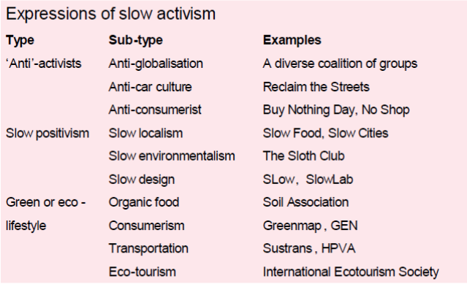
week 3: affirmative vs. critical design / fast vs. slow knowledge
+ Slow Activism
+ Anti-activists: disrupt/boycott
+ Slow positivists: promote slowness as a positive force/design this criteria into artifacts/experiences
+ Green/eco-lifestylists: adjustments to ways of living
+ All share a belief in slow knowledge

Slide 11

week 3: affirmative vs. critical design / fast vs. slow knowledge
+ Slow Knowledge vs. Fast Knowledge
+ Fast Knowledge Causes Problems:
+ Technological, profit oriented, hierarchical, competitive,
universally applied and cocky
+ Predominant knowledge in the global economy
+ Slow Knowledge Offers a Counter-Balance:
+ Shared and multi-disciplinary, shaped to particular cultural
and geographic contexts, humble
+ Belonging to communities/societies; open source
+ Evolution of nature and culture offer greater stability and longer histories than humans
+ W. Cooper: "One of the reasons ecosystems are so resilient is that they aren’t doing anything in a
hurry. The slower the flow rates, the more you can modulate the controls without wild fluctuations."
Fast >>>>>>>>>> Innovation
Art/Fashion
Commerce
Infrastructure
Governance
Culture
Nature
Slow >>>>>>>>>> Stability

Slide 12
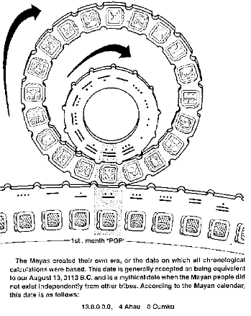
week 3: affirmative vs. critical design / fast vs. slow knowledge
+ Pluralistic Views of Time (Fuad-Luke)
+ lived time, experienced time - durée
+ real time – 24/7, always ‘on’, a ‘now’ economy; an absence of time for reflection
+ residence time – the time anything spends within a system
+ geologic time – rivers erode, trees ‘walk’ as climate changes, mountains are born or die
+ cultural time – time is asymmetrical, the past is visible, the future is not
+ time is progress (the ‘West’)
+ time is cyclic (indigenous peoples)
+ cow time (cycles of milking, Sudan)
+ scent time (time of flowering, India)
+ moral time (think seven generations ahead, First Peoples)
+ Buddhist time (infinite gratitude to past, infinite service to present,
infinite responsibility to future)
+ secular time – represents linear progress
+ sacred time – represents cyclic ‘being’
+ Secular Time:
+ Linear progress: fleeting moments; moving ever forward
+ Clocks, schedules, agendas
+ Uni-directional, chronological, utilitarian
+ The body, physical, finite; privilege the visual
+ Sacred Time:
+ Cyclical being: eternally 'now'
+ Eternity, beyond time
+ Qualitative, philosophical, meta-physical, spiritual
+ Cycle of time: birth, growth, death, decay

Slide 13
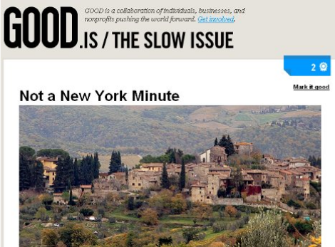
week 3: affirmative vs. critical design / fast vs. slow knowledge
+ Sacred Time is Slow Time
+ Imprecise, Fuzzy, Indistinct:
+ Brian Eno/Bruce Goff: "We have the frame we operate in which we call ‘now’. Now’ is all the
things that are affecting me. All the things I can affect in a certain time frame I shall call ‘now’."
+ The present is continuously with us (past is gone and future has not yet happened
+ Creativity is borne in the "continuous present"
+ It is the location/moment where critical action and thought can occur
+ Sustainability and Slowness:
+ The pleasure of mundane circumstances: "pleasure-over-time rituals”
+ The pandemic highlighted this reflection
+ Anne Cline: "What rituals of delay could
nourish us? Or have the virtual realities of
film and television made ever ‘real time’
tedious, and therefore slowed up time
unbearable?"
+ We have created disconnections from
the wider world
+ Slow Food:
+ Eating locally-grown, organic, native foods
+ Slow Cities:
+ Reclaiming streets for pedestrians and cyclists

Slide 14
week 3: affirmative vs. critical design / fast vs. slow knowledge
+ SLow Manifesto (Fuad-Luke, 2003)
+ Philosophy and Principles:
+ Design to slow human, economic and resource use metabolisms
+ Antidote to "fast design" thinking
+ Repositioning the focus of design on individual, socio-cultural and environmental well-being
+ Design to celebrate slowness, diversity and pluralism
+ Develop a new paradigm outside existing economic, technological, political thinking
+ Design encouraging a long view
+ Explore endurability (physical, spiritual, mental, emotional durability)
+ Process:
+ Comprehensive, holistic, inclusive, reflective, considered
+ Democratizing the design process by opening it up to broader stakeholders
(human-centered design processes, etc.)
+ Outcomes
+ Encourage a reduction in human, economic, industrial, and urban resource flow metabolisms
+ Design for people first, commercial interests second
+ First local, then global
+ Design for socio-cultural benefits and well-being
+ Catalyze behavioural changes and transformation
+ Eight overlapping themes: Tradition, ritual, experiential, evolved, slowness, eco-efficiency,
open source, technology

Slide 15
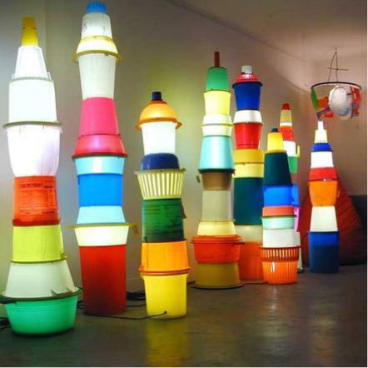
week 3: affirmative vs. critical design / fast vs. slow knowledge
+ Humanistic Dimensions
+ Slowing down – slowing down human metabolisms, less haste
+ Towards an [old] new social equity – sharing, a social conviviality
+ Interstices/interventions – exploring unseen rhythms and metabolisms
+ Renewal/re-think – re-connecting human endeavour with cyclicity and imbuing tasks with pleasure

Slide 16
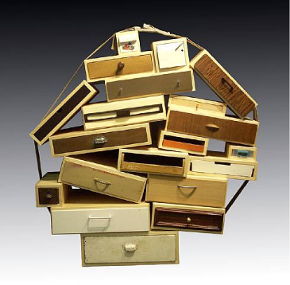
week 3: affirmative vs. critical design / fast vs. slow knowledge
+ DROOG Design
+ Co-founded by Renny Ramakers (Amsterdam and New York)
+ "Droog projects pioneer new design directions, new collaborations, creative tools and business
models that offer a unique perspective."
+ Studio profile
+ Go Slow (2004)
+ "Slowness is a quality that is hard to come by in our
modern urbanized world which is dominated by
speed and fast consumption. We are extremely busy.
We no longer follow processes. Our patience
does not extend to ‘slow’ and ‘difficult’. Things must be
easy and complete. Slowness is luxury.
Take your time. Experience processes. Enjoy attention
and care. Enjoy relaxation. Enjoy slowness."
+ Hotel DROOG (2002)

Slide 17
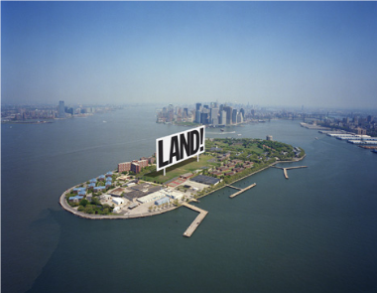
week 3: affirmative vs. critical design / fast vs. slow knowledge
+ DROOG Design
+ Saved by DROOG (2010)
+ "Every month about 500 companies in the Netherlands go bankrupt. Where do their products go? In
the past several months we have been bidding on liquidation auction items ranging from
handkerchiefs to dog baskets. [...] Having invited 14 designers to consider these items as raw
material for creative re-interpretation, the result is a new collection of 19 products, with outcomes
ranging from folding chairs manicured by nail artists, to handkerchiefs that distribute selected daily
news articles, to spoons with non-edible yet mouth-watering coatings. A pragmatic starting point
with surprising outcomes, the presentation celebrates the re-use potential of leftovers as a valid
approach to product design and development. All items were immediately available for sale in
editions dictated by the limited liquidation lot quantities."
+ Pioneers of Change (New York, Governor's Island, 2009)
+ "Visitors were tickled by a robot, they repaired broken
chairs and moth-eaten sweaters, chewed and
swallowed very slowly, watched real time pass by,
and filled their backpacks and purses with Dutch
design ware all under $100. [...] All this and more took
place in eleven former commanding officers'
houses in Nolan Park transformed by Dutch designers,
artists and architects in collaboration with
elderly New Yorkers, local students and the public."

Slide 18
week 3: affirmative vs. critical design / fast vs. slow knowledge
+ Assignment: Je me souviens (Part 1 due February 17; 20%)
+ Montreal as a UNESCO City of Design
+ What makes a "design city"?
+ Select an example of what you feel to be well-designed
+ Architecture, public parks, systems, street furniture, infrastructure, etc.
+ MUST be Montreal-specific
+ "Even the city itself acknowledges that ‘design in Montreal is not simply for show but a source of
daily wellbeing.’ Not only has Montreal demonstrated that design can be a powerful tool in
promoting inclusion and plurality of values, but the city has also called upon its citizens to play a
critical and active part in mobilizing design to inspire more innovative living environments that
enhance daily life and existence.” - Koichiro Matsuura (UNESCO Director-General)
+ Not just a celebration of Montreal's attributes
+ The second part of the assignment will address the less effective elements of the city
+ Think about inhabitation: how do these artifacts/experiences shape the daily life of citizens (for
better or for worse)?
+ Use the issues, frameworks, guiding principles explored in class
+ What contextual, semantic, and physical concerns need to be addressed/investigated?
+ Examine the patterns of use, appropriateness of material choices, and general mood/atmosphere
+ Is it workable/livable/enjoyable?
+ Does it make a positive contribution to the everyday experience?

Slide 19
week 3: affirmative vs. critical design / fast vs. slow knowledge
+ Assignment: Je me souviens (Part 1 due February 17; 20%)
+ Suggested Framework
+ Section I: Observation (500 words):
+ Ia: Briefly explain your choice; identify date/name of designer (if known); succinctly state its major
positive attributes (100 words)
+ Ib: Provide a brief history of your artifact/space, including key dates/transitions (100 words)
+ Ic: Provide a description of its visual and physical characteristics; include a map denoting its location
in the city (150 words, plus 10 photos/captions)
+ Id: Include a detailed description of its contextual environment (150 words); consider
+ Surfaces: hard/soft; changing/static
+ Size or volume: interior/exterior; confined/walled/open; reverb/echo/flat
+ Variety: balance of natural/human/manufactured phenomena; contrasts/similarities
+ Qualities: loud/quiet; harsh/sharp/soft/gentle
+ Layers: multiple simultaneous/discrete; easily-distinguished/seamless blend
+ Make sure that your photographs reveal different facets of the artifact
+ Verify that you are able to photograph in-situ (i.e. not private property)

Slide 20
week 3: affirmative vs. critical design / fast vs. slow knowledge
+ Assignment: Je me souviens (Part 1 due February 20; 20%)
+ Section II: Occupation (500 words)
+ IIa: How does the general public interact with your artifact? Who, how, when, and under what
circumstances? Does this change during the day or seasons? Is it available to all, or restricted to a
specific demographic? (250 words)
+ IIb: Consider the functionality of your artifact (perceived/purported practical functions). Is there a
discrepancy between this and the experience of the user? Can this be quantified? (250 words)
+ Section III: Analysis (500 words)
+ IIIa: Apply principles studied in DART 261/262 to justify your assessment
+ As a starting point, consider Dieter Rams' Ten Principles for Good Design
+ Consider durability of your artifact: both physical and emotional
+ Is your artifact healthy: physically, environmentally, socially?
+ Does it help the public in positive ways (not mere ornamentation)?
+ Is it responsive to human scale? Does it evoke a positive sentiment?
+ You must integrate a minimum of 3 sources from the course or elsewhere
+ Section IV: Conclusion (100 words)
+ Succinctly describe your reasoning for the positive assessment
+ How does it activate and reflect the culture of its time and place?
+ If your artifact is historical, how does it function today?

Slide 21
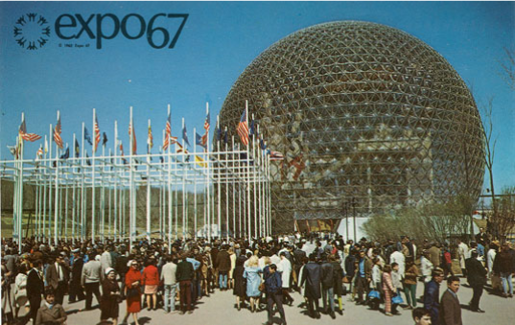
week 3: affirmative vs. critical design / fast vs. slow knowledge
+ Assignment: Je me souviens (Part 1 due February 17; 20%)
+ Deliverables:
+ Complete ALL 4 SECTIONS for the due date
+ Approximate length: 1600 words, plus captions (PDF FORMAT ONLY)
+ Photographs and captions should be integrated into the body of the text
+ Upload to Moodle

Slide 22
week 3: affirmative vs. critical design / fast vs. slow knowledge
+ Ready, Set, Go!
+ For Next Week:
+ Read: Fabricant, Robert. "Design with Intent." Design Mind on Good. (External link)
+ Read: Kuutti, Kari. “HCI and Design--Uncomfortable Bedfellows?" (Re)searching the Digital
Bauhaus. (Library reserve link)
+ Respond on Moodle:
+ Please post the prompt and identify the scenario explored in today's class. Elaborate on the
play session and upload your response to the week 3 Moodle forum.
+ Je me souviens--Part 1 (February 17)
+ Three weeks left! Choose your object/building/environment/experience this week!

