Slide 1
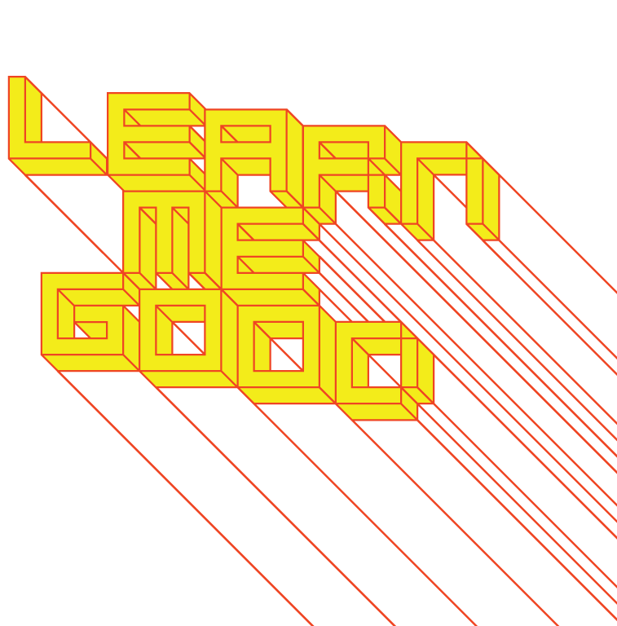
WEEK 5

Slide 2
week 5: design experiences I: cultivating empathy
+ Class schedule:
+ Presentation:
+ Empathy and design experiences
+ Tutorial (may go a bit longer):
+ Guest presentation by Mak Ékoué
+ ANGRY WATER BOTTLES!
+ Assignment Due Next Week (February 17)!
+ Part 1: Je me souviens

Slide 3
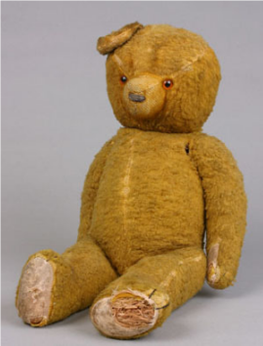
week 5: design experiences I: cultivating empathy
+ Jigme Singye Wangchuck (1972)
+ “Gross National Happiness is more important than Gross National Product.”
+ Jonathan Chapman, Emotionally Durable Design: Objects, Experiences & Empathy
+ "Contrary to popular misconception, it is the subtle and more ephemeral user experiences that
penetrate the psyche through the slow and steady passing of time. Intense user experiences, such
as those gained from igniting a firework, or achieving up to 100 kilometres per hour in less than four
seconds, for example, are indeed powerful; yet they are fleeting and are seldom revisited by users.”
+ Intensity of experience is not the most useful or accurate judgment
of durability
+ Subtle, everyday gestures leave more lasting impressions
+ Intimacy and connection develop over time (not instantaneous
rush of consumption)
+ Each interaction allows the relationship to grow
+ Most users barely recognize the experience in a conscious manner
+ Subconscious actions are the most powerful—they establish strong
and durable connections on both rational and emotional levels

Slide 4
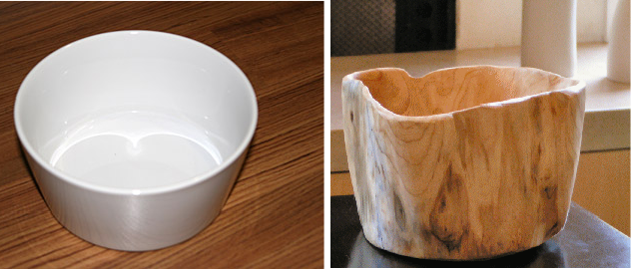
week 5: design experiences I: cultivating empathy
+ Jonathan Chapman, Emotionally Durable Design: Objects, Experiences & Empathy
+ Example: Salad Serving
+ White ceramic bowl versus natural wood bowl

Slide 5
week 5: design experiences I: cultivating empathy
+ Jonathan Chapman, Emotionally Durable Design: Objects, Experiences & Empathy
+ Example: Salad Serving
+ White ceramic bowl versus natural wood bowl
+ Resonant sound; contrast of colours
against white; perception of purity
and precision; timeless material;
reflective surface amplifies colours;
cold to touch
+ This doesn’t even address the semantic elements: shape, size, proportion, etc.
+ “Micro experiences” add up—each experience is important in fundamental ways
+ Thicker walls; lower material density
means less weight; softness and irregularity
to material (suggests calm, numbness);
ambient temperature; sense of uniqueness
through the variegated surface (shoppers
examine several to find individual markings)

Slide 6
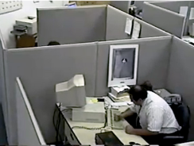
week 5: design experiences I: cultivating empathy
+ Experience Design
+ “Life is filled with experiences, all of which may be described as meaningful as they empower us to
formulate conceptual frameworks of reference, which serve to rationalize the complex world in
which we live.”
+ If these experiences can be observed critically, isolated and analyzed, it stands to reason that they
can also be designed
+ Use innate understandings to control the desired experience of the user
+ Dysfunctional Design
+ Broken or poorly-functioning artifacts can often create stronger emotional bonds
+ “Though examples do exist, we seldom witness users affectionately stroking and caressing
machines after they perform well; most users, however, are prepared to invest an enormous degree
of emotional outlay in dysfunctional objects, such as physically assaulting a broken ticket machine,
pressing the buttons irrationally hard on a remote control with duff batteries or clicking a desktop
icon an eleventh time because nothing happened the previous ten.”
+ Example: elevator buttons; broken EV building elevators
+ Manufactured objects have a huge influence over our everyday lives
+ Interaction is an invisible process—until it misbehaves

Slide 7
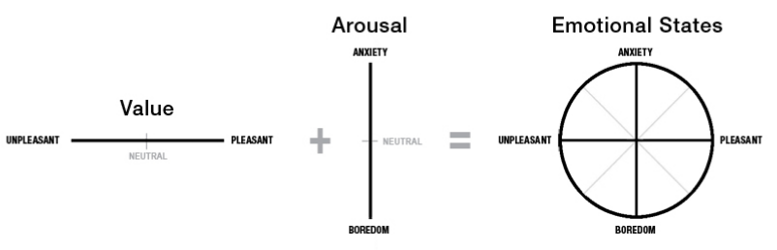
week 5: design experiences I: cultivating empathy
+ Arousal
+ Moderate arousal can focus attention and enhance performance
+ Extreme arousal can create tension and anxiety, inhibiting performance
+ Can affect usability (misinterpretation)
+ Establish a balance: basic, functional interaction with levels of emotional arousal
+ Example: children seek attention by inciting arousal through misbehaviour
+ Acknowledge presence: healthy assertion of one’s free will and agency
+ Trevor van Gorp, "Defining Emotion, Personality and Relationship":

Slide 8
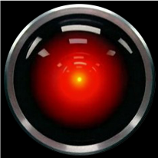
week 5: design experiences I: cultivating empathy
+ Failed Promises
+ We come to expect objects to fulfill our desires perfectly, always, and forever
+ Setting high expectations for material artifacts leads to inevitable failure
+ “According to Yin and Yang, material culture has lost its balance and therefore must be swung
away from convenience and servitude where it now lies, back toward the labour intensive and
temperamental. Once the conceptual balance is restored, it becomes possible to foresee objects
with a naughty, cheeky side to their personality: objects that have sudden mood swings; get
sick; go through dysfunctional puberties; get bored; or just simply misbehave from time to time.”
+ 2001: A Space Odyssey (Dir. Stanley Kubrick)
+ Being too high maintenance can also be problematic and a source of frustration
+ Most users do not want to “…train their alarm clock how to tell the time, clean up after their stereo
or traipse the dark streets and alleyways in search of the pubescent TV set that stormed out of
the house earlier that day.”
+ The emotional experience is too intense—there is already enough drama in our human dynamics!
+ Design objects with a greater degree of “openness” (not static: the classical
industrial design model)
+ Allow for symbolic exchange—the relationship with the user will grow and
take on further significance and meaning
+ Relationship to sustainable practice: ENDURANCE

Slide 9
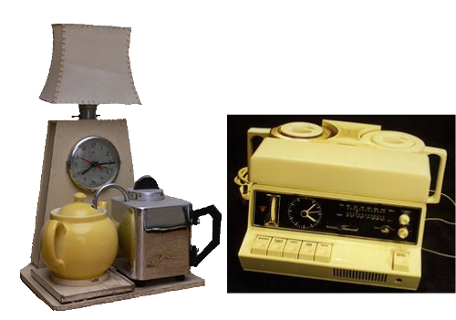
week 5: design experiences I: cultivating empathy
+ Speed
+ The speed at which artifacts become obsolete has grown exponentially
+ We no longer hold onto objects for long periods of time
+ Leads to decreased emotional durability—we do not build lasting relationships
+ Qualitative user experiences are seen as “value-added” secondary concerns
+ Common approach: just add more functionality (“Swiss Army Knife” approach)
+ Example: Goblin automatic tea-maker (Teasmade, early 1900s)
+ Originally came with 2 cups/saucers, cream/sugar
+ 1980s: night-light, radio, analogue clock, alarm (with 6 melodies), flower vase
+ Service example: Starbucks
+ Myriad selection of choices, variations,
and preferences that detract from the
experience of going out for coffee
+ Symptomatic of postmodern, pluralistic
culture: perception of choice
+ Choice needs to be managed, in order to
restore sense of experience
(not prescriptive)
+ Teasmade Goblin (1936)
+ Goblin 870 (1979)

Slide 10
week 5: design experiences I: cultivating empathy
+ User Experience
+ Great consideration given to complex and digitally-mediated interactions—little for mundane,
everyday objects
+ Arguably, these common forms have greater influence (sinks, toilets, door handles, etc.)
+ “The most important concept to grasp is that all experiences are important and that we can learn
from them, whether they are traditional, physical, offline experiences or whether they are digital,
online or other technological experiences.”
+ Hybridization and cross-pollination of multiple design disciplines (and other related fields)
+ Experience Design
+ Greater subject-object intimacy
+ Create relationships with individuals, not mass markets (possibilities of customization, etc.)
+ More empathetic approach than conventional design
+ Utilize non-traditional methods/processes: theatre, dance, performance as models for communication
+ Meta-design practice that is not necessarily discipline-specific—deployed in a variety of ways
+ Transcends the rationality of rules and principles
+ Klaus Krippendorff (on process):
+ “Designers consider possible futures, worlds that can be imagined and could be created in
real time.”
+ “To choose among them, designers evaluate the desirability of these futures.”
+ “Designers search the present for variables, things they are able to vary.”
+ “Designers create and work out realistic paths from the present toward desirable futures and
propose them to those who can bring a design to fruition.”

Slide 11
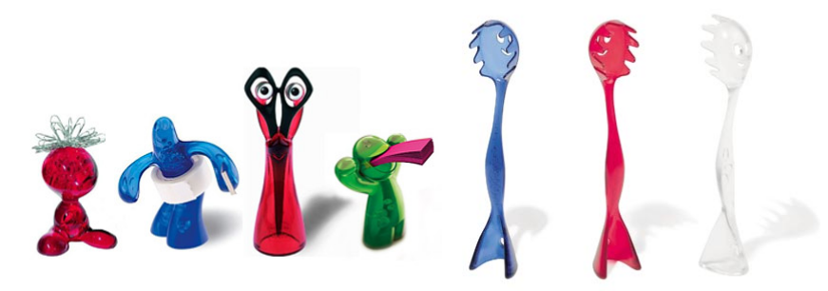
week 5: design experiences I: cultivating empathy
+ Mystification of Function
+ Objects are becoming increasingly technologically-enabled
+ Greater focus on the software than the “box” (Fukasawa: design “dissolving into behaviour”)
+ Moving well beyond basic usability/need
+ Demand for materiality to imbue emotional characteristics to balance the mystification
+ “In migrating toward the virtual, we become in danger of subscribing to an experience-impoverished
future: an immaterial world of trite engagements with anonymous objects, devoid of qualitative user
experiences.”
+ Paul Levinson: "I think most of us appreciate the efficiency of technology, but at the same time there
is an aspect of technology we find ugly because it is not part of us. It doesn't have blood; it is not
soft or intelligent. [Cuddletech] is a craving for that which feels more human to us."
+ Koziol: "Ideas for Friends"

Slide 12
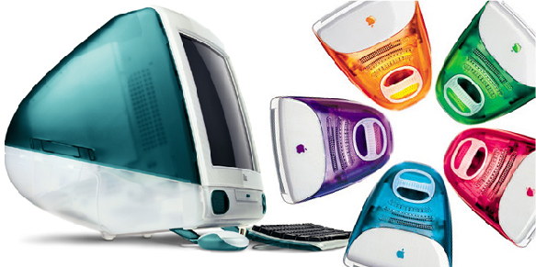
week 5: design experiences I: cultivating empathy
+ Cuddletech
+ iMac: Bondi Blue (1998)
+ Computers are no longer bland, beige machines: objects
+ Consumers bought the iMac less for the features, processing power, and upgradability
(little)—aesthetic appeal ruled
+ A simplified new interface promoted seamless integration with the escalating Internet craze
+ Promoted almost exclusively as a web device: one button and you’re online
+ Steve Jobs introduces the first iMac (1998)
+ Computers are further interpenetrating areas of our domestic lives
+ Cuddletech possibly suggests a greater comfort level with the intrusion of technology
+ Conversely: it appeases the fears of less tech-savvy communities
+ Hartmut Esslinger (Frog): "The computer should be a mirror of your own personality. I'm an
intelligent, caring person—
why shouldn't I have an intelligent,
caring computer?"
+ The legacy of the iMac and Apple
products has been pervasive
since 1998

Slide 13
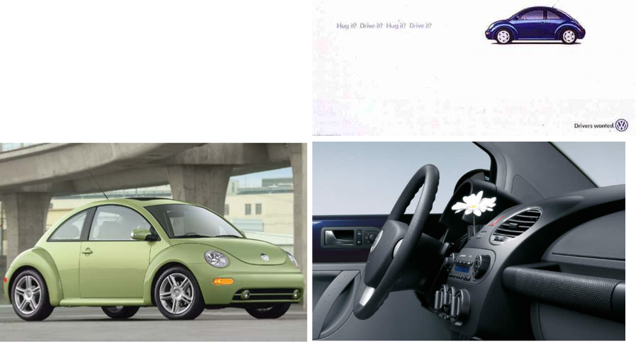
week 5: design experiences I: cultivating empathy
+ Cuddletech
+ The new VW Beetle (1998)
+ Slogan: "Hug it? Drive it? Hug it? Drive it?"
+ Integration of vase in dashboard
+ Cartoonish bubble curves
+ Volkswagen Autostadt
+ Theme park

Slide 14
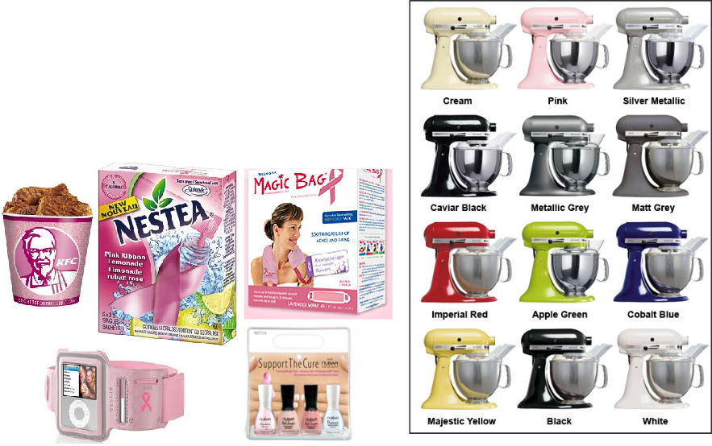
week 5: design experiences I: cultivating empathy
+ Cuddletech
+ KitchenAid appliances
+ Pink products for breast cancer awareness—creating
empathy as a marketing tool
+ Manufacturers have seen clever “design” as a means
to connect with audiences through cute styling
+ Elicit heartwarming feelings—especially in
anthropomorphized artifacts (Koziol/Alessi)
+ Pink Ribbons Inc.

Slide 15
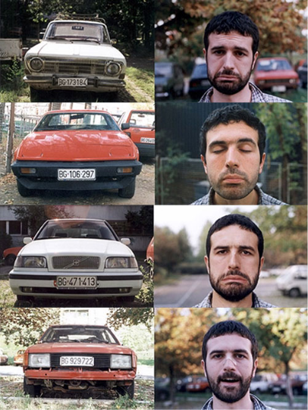
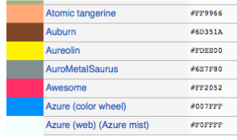
week 5: design experiences I: cultivating empathy
+ Cuddletech
+ Alisa Gordaneer: "Signs of cuddletech have been
popping up for the last several years … it's clear
that some small revolution in industrial design has
mandated that consumer goods should be--not
just functional, not just fun--but irresistibly adorable."
+ Established visual cues have always been employed
by designers to elicit emotions
+ List of Colours
+ Car “faces”

Slide 16

week 5: design experiences I: cultivating empathy
+ Cognitive Meaning + Arousal = Emotion (Gerald Cupchik)
+ A meaningful association needs to be perceived by the user before arousal can occur
+ Cognitive meaning sets the stage for any further development of emotion
+ “Emotional responses make up the very foundations of individuality; they are what distinguish us
from others. Through choice, simulation and association, products provide triggers for this vital
sociological process to occur.”
+ No two people will perceive an artifact in the same way
+ Based on conditioning, education, and experiences in the world
+ “Personal experiences and emotional meanings complete the image of the object whose
appearance and functions are but initial cues as to their broader meaning. The more an
individual consciously or unconsciously relates to the sensory/aesthetic, cognitive/behavioural,
and personal/symbolic qualities of an object, the more profound will be the attachment.”
+ Kuleshov Effect (1910-1920)

Slide 17
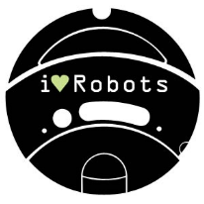
week 5: design experiences I: cultivating empathy
+ Constructing Experience
+ Hartmut Esslinger (Frog): "People spend their money not focused on industries but on experiences.
One good experience could be a computer and another could be a long weekend vacation."
+ Klaus Krippendorff: “’…design is a natural human activity and everyone designs all the time.’ When
someone plans a vacation trip, rearranges the furniture in the living room, treats a patient, reads or
writes a letter, draws a cartoon, or tends to a garden, future possibilities are envisioned, evaluated,
acted upon, and exhausted.”
+ Accumulation of Meaning
+ Begins long before the point of purchase
+ Subject-object relationships developed through advertisements, floor models, other daily contexts
(friend’s home, work scenarios, etc.)
+ The stronger the emotional draw, the greater the levels of intimacy that will emerge over time
+ It is not about “maintaining” the attachment (this leads to stagnation)
+ Similar to human relationships
+ Repeated exposure can reduce the attachment, causing tension and resentment (i.e. playing the
same album over and over)
+ Highly-evolved relationships result in “conceptual unification of tool and hand”
+ Experience of using the artifact is greater than the product itself
+ iRobot Roomba Skins
+ iRobot Developer Community

Slide 18
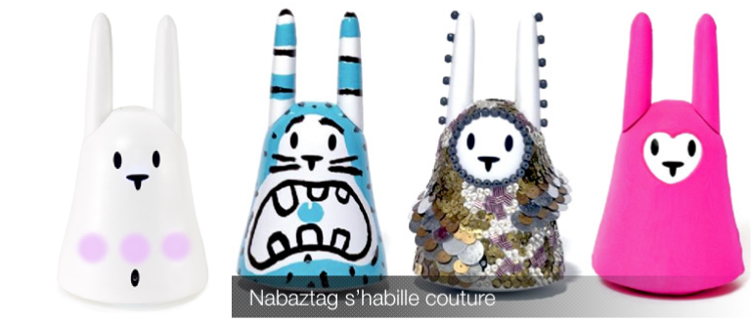
week 5: design experiences I: cultivating empathy
+ Re-humanization of Design
+ Conventional design tends to dehumanize technology—set apart in a distant category
+ Reduced to minimalist appearance and lack of physical presence
+ Chris Pacione (Sandbox): "Product identity in the future is going to be less logo and more how you
use it."
+ Tucker Veimeister (Frog): "Most people understand that having a pet plays a very functional role in
people's well-being. It makes them feel happy to have the companionship. The same is true about
inanimate objects. A beautiful room is more practical than an ugly one. That is practical."
+ Nabaztag/Karotz

Slide 19
week 5: design experiences I: cultivating empathy
+ Assignment: Je me souviens (Part 1 due February 17; 20%)
+ Montreal as a UNESCO City of Design
+ What makes a "design city"?
+ Select an example of what you feel to be well-designed
+ Architecture, public parks, systems, street furniture, infrastructure, etc.
+ MUST be Montreal-specific
+ "Even the city itself acknowledges that ‘design in Montreal is not simply for show but a source of
daily wellbeing.’ Not only has Montreal demonstrated that design can be a powerful tool in
promoting inclusion and plurality of values, but the city has also called upon its citizens to play a
critical and active part in mobilizing design to inspire more innovative living environments that
enhance daily life and existence.” - Koichiro Matsuura (UNESCO Director-General)
+ Not just a celebration of Montreal's attributes
+ The second part of the assignment will address the less effective elements of the city
+ Think about inhabitation: how do these artifacts/experiences shape the daily life of citizens (for
better or for worse)?
+ Use the issues, frameworks, guiding principles explored in class
+ What contextual, semantic, and physical concerns need to be addressed/investigated?
+ Examine the patterns of use, appropriateness of material choices, and general mood/atmosphere
+ Is it workable/livable/enjoyable?
+ Does it make a positive contribution to the everyday experience?

Slide 20
week 5: design experiences I: cultivating empathy
+ Assignment: Je me souviens (Part 1 due February 17; 20%)
+ Suggested Framework
+ Section I: Observation (500 words):
+ Ia: Briefly explain your choice; identify date/name of designer (if known); succinctly state its major
positive attributes (100 words)
+ Ib: Provide a brief history of your artifact/space, including key dates/transitions (100 words)
+ Ic: Provide a description of its visual and physical characteristics; include a map denoting its location
in the city (150 words, plus 10 photos/captions)
+ Id: Include a detailed description of its contextual environment (150 words); consider
+ Surfaces: hard/soft; changing/static
+ Size or volume: interior/exterior; confined/walled/open; reverb/echo/flat
+ Variety: balance of natural/human/manufactured phenomena; contrasts/similarities
+ Qualities: loud/quiet; harsh/sharp/soft/gentle
+ Layers: multiple simultaneous/discrete; easily-distinguished/seamless blend
+ Make sure that your photographs reveal different facets of the artifact
+ Verify that you are able to photograph in-situ (i.e. not private property)

Slide 21
week 5: design experiences I: cultivating empathy
+ Assignment: Je me souviens (Part 1 due February 17; 20%)
+ Section II: Occupation (500 words)
+ IIa: How does the general public interact with your artifact? Who, how, when, and under what
circumstances? Does this change during the day or seasons? Is it available to all, or restricted to a
specific demographic? (250 words)
+ IIb: Consider the functionality of your artifact (perceived/purported practical functions). Is there a
discrepancy between this and the experience of the user? Can this be quantified? (250 words)
+ Section III: Analysis (500 words)
+ IIIa: Apply principles studied in DART 261/262 to justify your assessment
+ As a starting point, consider Dieter Rams' Ten Principles for Good Design
+ Consider durability of your artifact: both physical and emotional
+ Is your artifact healthy: physically, environmentally, socially?
+ Does it help the public in positive ways (not mere ornamentation)?
+ Is it responsive to human scale? Does it evoke a positive sentiment?
+ You must integrate a minimum of 3 sources from the course or elsewhere
+ Section IV: Conclusion (100 words)
+ Succinctly describe your reasoning for the positive assessment
+ How does it activate and reflect the culture of its time and place?
+ If your artifact is historical, how does it function today?

Slide 22
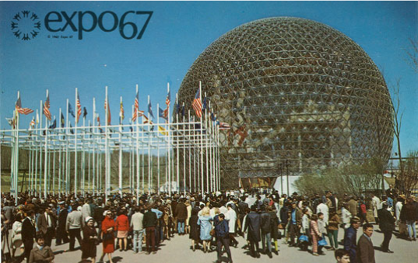
week 5: design experiences I: cultivating empathy
+ Assignment: Je me souviens (Part 1 due February 17; 20%)
+ Deliverables:
+ Complete ALL 4 SECTIONS for the due date
+ Approximate length: 1600 words, plus captions (PDF FORMAT ONLY)
+ Photographs and captions should be integrated into the body of the text
+ Upload to Moodle

Slide 23
week 5: design experiences I: cultivating empathy
+ Ready, Set, Go!
+ For Next Week:
+ Read: Turkle, Sherry. “Introduction: The Things that Matter.” Evocative Objects. pp.3-10.
+ Read: Csikszentmihalyi, Mihaly. “Design and Order in Everyday Life.” Design Issues. vol. 8, no. 1,
pp. 26-34.
+ Choose teams of 3 for final parts of major assignment
+ Post you team members to Moodle
+ Each individual must come to class with a proposed example of ineffective design in Montreal.
+ Optional Resources:
+ Read: Attfield, Judith. “The Meaning of Things: Design in the Lower Case.” Wild Things. pp. 75-95.
+ Respond to Tutorial Prompt (Moodle):
+ Please post the prompt and identify the scenario explored in today's class. Elaborate on the
play session and upload your response to the week 5 Moodle forum.
+ Je me souviens--Part 1

