Slide 1
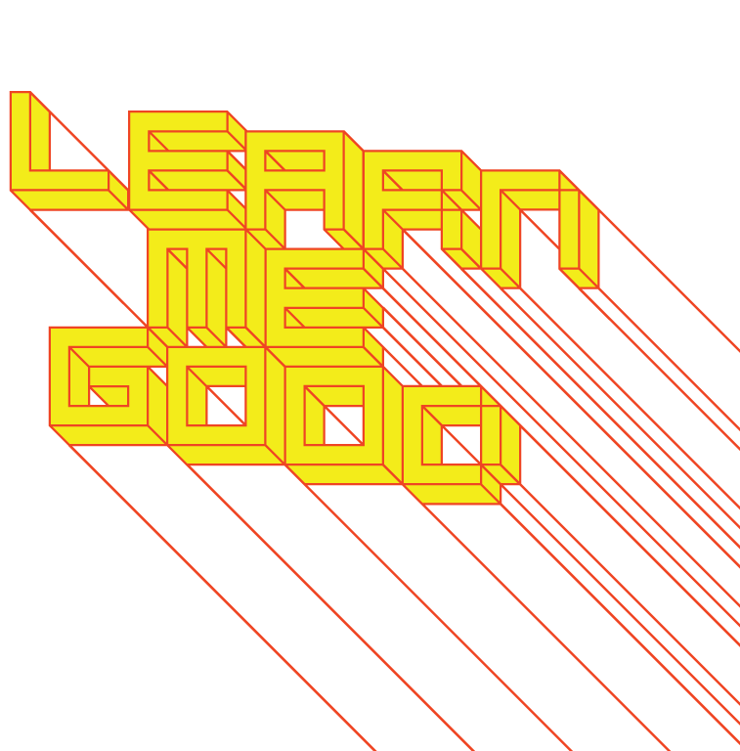
WEEK 7

Slide 2
week 7: stakeholders: complexity and collaboration (intro.)
+ Class schedule:
+ Screening: Into Eternity (Dir. Michael Madsen)
+ Available to stream on Kanopy via the Concordia Library website
+ Presentation: An Introduction to Stakeholder Networks
+ Tutorial: Course Advising

Slide 3
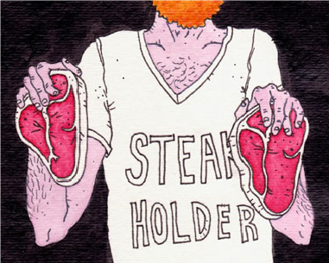
week 7: stakeholders: complexity and collaboration (intro.)
+ Stakeholders
+ The design process involves many different individuals who have a vested interest in the outcomes
+ Clients, engineers, CEOs, financiers, sales people, research institutions, etc.
+ Little focus on these individuals - more information and writing on the role of THE USER
+ Suggests a singular uniformity, but the THE user is a myth - a statistical improbability
+ Ergonomics: average size data sorted into male/female, but how many actually fall into the
average range?
+ Klaus Krippendorff: "Statistically, there are about as many males of the average women
size as there are women of the average male size."
+ People rarely conform to all "average" statistical attributes (eg. 2.3 children)
+ A result of industrialization: appeal to the greatest number of targeted "end users"
+ "Before a product reaches its intended user group, it passes
through the hands of many who use it for a variety of
reasons: to solve an engineering problem, to keep jobs in
a factory, to profit from increased sales, or to supply
supporting gadgets. After its intended use, it may become
of interest to repair shops, benefit recycling companies, and
become an ecological nightmare for communities that live
near dumps. All of these people and many more could be
said to "use" industrial products, albeit in ways that are at
variance with the simple end-user or consumer concept.
Limiting design concerns to this fictional end-user at the
expense of all other people who are touched by a design
presents a serious problem."

Slide 4
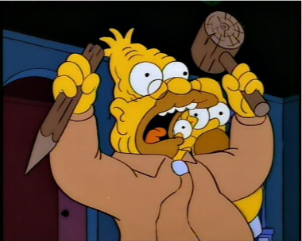
week 7: stakeholders: complexity and collaboration (intro.)
+ Respect
+ The designer must respect the agency of individuals, while also considering the network of
stakeholders
+ "By definition, stakeholders:
- Claim their stake (interest) in a technological development (a design or its consequences)
- Are experts in their own worlds and usually very knowledgeable about the stake they claim in
that development
- Are willing to act in support or opposition of that development
- Are willing to mobilize the resources they command: information, expertise, money, time,
connections to members of their communities, and the powers of the institutional roles they
occupy"
+ The individual who purchases a technology may not be
the one who uses it - or, one among many
+ This approach is less about "design-as-problem-solving"
>>> "design-as-social-process"
+ Stakeholders in the network often have conflicting
interests and motivations (profits versus
sustainable development, etc.)
+ Acknowledge the roles each play in the design
process (does not necessarily mean that you
can appease all)
+ Design involves listening

Slide 5

week 7: stakeholders: complexity and collaboration (intro.)
+ Stakeholder Networks
+ Stakeholder Responsibilities
+ Designers are also stakeholders
+ Many stakeholders represent the interests of other parties
+ The people with whom they communicate are often just points of departure
for larger networks - branching out to wider communities
+ Client --> bosses, corporate interests, the public, etc.
+ Stakeholder Characteristics
+ "Stakeholders are political actors in pursuit of their own agendas"
+ Voice support or opposition, based on what the design means to them
+ "Stakeholders attempt to alter the manifestations they have access to"
+ Designs get altered at each stage of development, according to the knowledge, opinions, and
expertise of each stakeholder along the lifecycle continuum
+ Designer --> client approval --> engineering drawings --> mechanical manufacturing
processes --> sales people/marketing --> consumer use --> recycling processes --> critics and
advocacy groups ...
+ "Stakeholders act in their own world, but in the awareness of different ones"
+ Pursue own agenda, but recognize that cooperation must exist to enable the process
+ "Stakeholders emerge whenever desirable possibilities or undesirable prospects become
apparent"
+ Example: "New Coke" - stakeholders spontaneously emerged to protest this new
development; the solution was to produce "Coca Cola Classic"
+ Designs producing mutually beneficial results are more likely to succeed

Slide 6
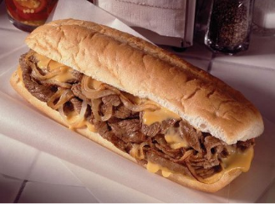
week 7: stakeholders: complexity and collaboration (intro.)
+ Stakeholder Networks
+ Stakeholder Characteristics
+ "Stakeholders, by communicating their actions, create other stakeholders"
+ In the production process, the stakeholders are typically predictable
+ In the larger world, these can be less controlled/managed
+ Example: consumer advocacy groups calling for manufacturing changes, etc.
+ "Stakeholders organize themselves into interest groups with compatible political agendas"
+ Like-minded individuals unite to pool resources, call for policy changes (groups are more
difficult to address or hold responsible for their actions than individuals)
+ "Designers are but stakeholders as well"
+ Designers require cooperation from others to realize a vision and its lifecycle
+ Good designs embrace the stakes of its diverse stakeholders, not just the designers'"

Slide 7
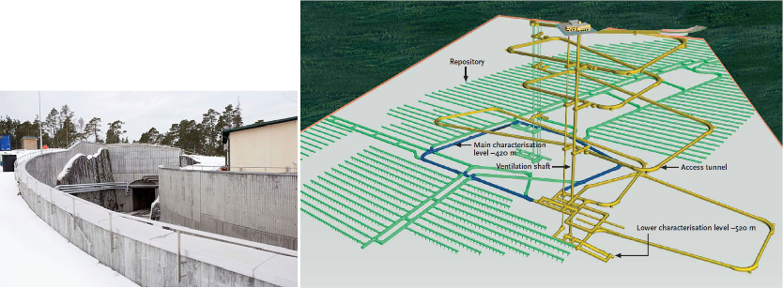
week 7: stakeholders: complexity and collaboration (intro.)
+ Case Study: ONKALO, The World's First Permanent Nuclear Waste Repository (Posivia Oy)
+ ONKALO is the Finnish word for "hiding place"
+ The focus of the project is to isolate nuclear waste from all living organisms, rather than store it in
interim facilities ("independent of human nature")
+ First conceptualized in 1947; work on realizing the project began in the 1970s
+ No working person will live to see it finished in 2100 - it will be capped off and back-filled shortly after
+ Designed to last 100,000 years (the length of time before the waste is no longer
radioactive/radiotoxic)
+ Michael Madsen: "The ONKALO project of creating the world's first final nuclear waste facility
capable of lasting at least 100,000 years, transgresses both in construction and on a philosophical
level all previous human endeavours.”

Slide 8
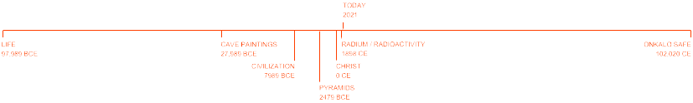
week 7: stakeholders: complexity and collaboration (intro.)
+ Into Eternity, Dir. Michael Madsen (2010)
+ "It is difficult for human beings to understand time spans beyond a few generations, let alone
thousands of years. To put time into perspective, we need milestones: The human species as we
know it today is believed to have existed for approx. 100,000 years. The oldest cave paintings,
known today, are approx. 30,000 years old, the pyramids approx. 4,500 years old, the Birth of
Christ, [2026] years ago, the detection of radiation approx. [120] years ago."
+ "Most ancient languages have been forgotten over time, and have had to be rediscovered to be
understood by us in present time. Some languages we have yet to decode. It is an open question if
and how we can communicate with an unknown and very distant future about complicated issues
like nuclear waste and radiation. Scientific studies have been conducted in relation to nuclear waste
storages, but the studies were ended as the US Academy of Science deemed it impossible to
secure communication with any scientific certainty over a period of 100,000 years."
+ How do we design projects for eternity - or, at the very least, an indefinite future?
+ No built structure has lasted even one-tenth of this facility's intended lifespan
+ If ONKALO succeeds, it will become the longest-lasting product of contemporary civilization (which it might outlive)
+ ONKALO is a clear illustration of our society's legacy and short-sightedness
+ Theories of "The Long Now" are put into real-world practice (a tremendous, but necessary risk)
6

Slide 9
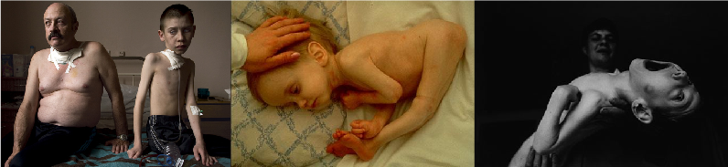
week 7: stakeholders: complexity and collaboration (intro.)
+ Into Eternity, Dir. Michael Madsen (2010)
+ Preventing Another Chernobyl or Three Mile Island
+ Nuclear power is not sustainable
+ Uranium is a finite resource (just like oil, tar, coal, etc.)
+ Finite space to store waste
+ Economically prohibitive (this was recognized even back in the 1970s)
+ Extremely hazardous; essentially impossible to reprocess materials or detoxify (produces
Plutonium - the main component of bombs)
+ The only option is large pools - typically aboveground
+ Susceptible to geological shifts, natural catastrophies, wars, climate changes (continental drift,
global warming, volcanic/seismic activity, floods, etc.)
+ Uranium is a very volatile, unstable material (it takes 40-60 years just to cool the rods below 100 degrees Celsius)
+ ONKALO is only designed to address the current nuclear production in Finland (4 reactors)
+ Canada (43); US (104); France (58); Japan (54) ...
+ 30 countries: 449 nuclear reactors; 15 countries: 60 under construction

Slide 10
week 7: stakeholders: complexity and collaboration (intro.)
+ Into Eternity, Dir. Michael Madsen (2010)
+ Sending Warning Messages into the Future
+ How do we address communications with populations in a distant future? (endurability)
+ Different language
+ Different biology/physiology
+ Different set of ethics
+ Different modes of dwelling
+ Different chemical compounds, flora, fauna
+ Different temperatures/atmospheric conditions
+ Possible inhabitation by non-human intelligent life
+ "We don't know what we don't know"
+ Questions
+ Should the site be marked? With what? How?
+ Symbols, language, "hieroglyphs"?
+ Could the spent uranium (plutonium) be perceived as a treasure? (like the pyramids of Egypt)
+ Our curiosity drives us towards situations where we are being told not to do things
+ Suggestion of an ancient burial site
+ If it is unmarked, how does this information get passed to future generations?
+ Government policy, archives, oral histories?
+ Who maintains control/responsibility? Who guarantees that it is translated to new languages
over the 100,000-year lifespan?
+ How do we "remember forever to forget"

Slide 11
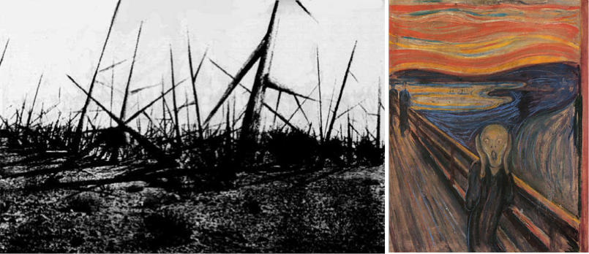
week 7: stakeholders: complexity and collaboration (intro.)
+ Into Eternity, Dir. Michael Madsen (2010)
+ Emotional Marking
+ Is it possible to communicate a warning/do not trespass message through form and aesthetic
elements?
+ Are there any fundamental human responses that can be evoked in this manner?
+ Can we control the design elements to ward off intruders--for their own safety?
+ Is there a biological/neurological/perceptual basis to this act of persuasion?
+ 100,000 years on, will this be fundamentally altered?

Slide 12
week 7: stakeholders: complexity and collaboration (intro.)
+ Into Eternity, Dir. Michael Madsen (2010)
+ Emotional Marking
+ "A perennial pop-science debating topic surrounding places like ONKALO is the question of
whether we should try to tell our descendants about them, and if so, how. There's no shortage of
ideas: A Stonehenge-style circle of obelisks, with detailed warnings in every United Nations
language (and blank stones to accommodate languages of the future). Symbolic sculptures built
on the site, such as a forbidding thicket of thorns. Wordless red signs using the contemporary
symbols for radiation and poison, alongside a human figure running away. A copy of Edvard
Munch's painting 'The Scream,' which, as one person observes, would radiate danger and
menace to any possible human viewer." - Andrew O'Hehir, Salon
+ Exercise:
+ In groups of 3-4, map as many of the stakeholders involved in ONKALO (past/present, future, far- future) as you can:
+ Consider all possibilities for future inhabitants
+ Develop a world model for the year 102,026 that addresses the key factors of our existence: geographical, political, physiological, ecological, sensorial, sociocultural, ethical, etc.
+ Speculate and brainstorm a way to address the long-term communication issues associated with ONKALO. How can we ensure that our hiding place stays hidden?

Slide 13
week 7: stakeholders: complexity and collaboration (intro.)
+ Assignment: Je me souviens (Part 2 due March 31; Groups of 3; 20%)
+ Montreal as a UNESCO City of Design
+ What makes a "design city"?
+ Select an example of what you feel to be well-designed
+ Architecture, public parks, systems, street furniture, infrastructure, etc.
+ MUST be Montreal-specific
+ "Even the city itself acknowledges that ‘design in Montreal is not simply for show but a source of
daily wellbeing.’ Not only has Montreal demonstrated that design can be a powerful tool in
promoting inclusion and plurality of values, but the city has also called upon its citizens to play a
critical and active part in mobilizing design to inspire more innovative living environments that
enhance daily life and existence.” --Koichiro Matsuura (UNESCO Director-General)
+ Not just a celebration of Montreal's attributes
+ The second part of this assignment addresses the less effective elements of the city
+ Think about inhabitation: how do these artifacts/experiences shape the daily life of citizens (for
better or for worse)?
+ Use the issues, frameworks, guiding principles explored in class
+ What contextual, semantic, and physical concerns need to be addressed/investigated?
+ Examine the patterns of use, appropriateness of material choices, and general mood/atmosphere
+ What prevents it from being workable/livable/enjoyable?
+ Why doesn't it provide a more positive contribution to the everyday experience?

Slide 14
week 7: stakeholders: complexity and collaboration (intro.)
+ Assignment: Je me souviens (Part 2 due March 31; Groups of 3; 20%)
+ Suggested Framework (Same criteria as Part 1)
+ Section I: Observation (500 words):
+ Ia: Briefly explain your choice; identify date/name of designer (if known); succinctly state its major
positive attributes (100 words)
+ Ib: Provide a brief history of your artifact/space, including key dates/transitions (100 words)
+ Ic: Provide a description of its visual and physical characteristics; include a map denoting its location
in the city (150 words, plus 10 photos/captions)
+ Id: Include a detailed description of its contextual environment (150 words); consider
+ Surfaces: hard/soft; changing/static
+ Size or volume: interior/exterior; confined/walled/open; reverb/echo/flat
+ Variety: balance of natural/human/manufactured phenomena; contrasts/similarities
+ Qualities: loud/quiet; harsh/sharp/soft/gentle
+ Layers: multiple simultaneous/discrete; easily-distinguished/seamless blend
+ Make sure that your photographs reveal different facets of the artifact
+ Verify that you are able to photograph in-situ (i.e. not private property)

Slide 15
week 7: stakeholders: complexity and collaboration (intro.)
+ Section II: Occupation (500 words)
+ IIa: How does the general public interact with your artifact? Who, how, when, and under what
circumstances? Does this change during the day or seasons? Is it available to all, or restricted to a
specific demographic? (250 words)
+ IIb: Consider the functionality of your artifact (perceived/purported practical functions). Is there a
discrepancy between this and the experience of the user? Can this be quantified? (250 words)
+ Section III: Analysis (500 words)
+ IIIa: Apply principles studied in DART 261/262 to justify your assessment
+ As a starting point, consider Dieter Rams' Ten Principles for Good Design
+ Consider durability of your artifact: both physical and emotional
+ Is your artifact healthy: physically, environmentally, socially?
+ Does it help the public in positive ways (not mere ornamentation)?
+ Is it responsive to human scale? Does it evoke a positive sentiment?
+ You must integrate a minimum of 3 sources from the course or elsewhere

Slide 16
week 7: stakeholders: complexity and collaboration (intro.)
+ Section IV: Proposal (400 words)
+ Propose a solution to rectify the problems identified in the analysis
+ Provide sketches, diagrams, and a 400-word written description of the changes
+ This will lead up to Part 3 of the assignment, which will entail a 3-poster set
+ You may wish to divide up the sections among your team members to make the most optimal use of
your time/energies
+ Section V: Conclusion (100 words)
+ Succinctly describe your reasoning for the positive assessment
+ How does it activate and reflect the culture of its time and place?
+ If your artifact is historical, how does it function today?
+ Video/Oral Presentation (Week 11/12)
+ Each team will present their research and proposals in 10-15-minute sessions
+ 5-minute (MAX!) video presentation, followed by Q&A session
+ It is recommended that you use a video sharing site (YouTube, Vimeo, etc.) and provide a link
+ All files MUST be uploaded to Moodle prior to the class session to expedite the process
+ Order will be determined randomly
+ You MUST attend all sessions

Slide 17
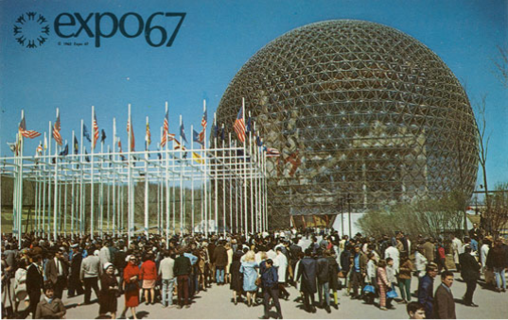
week 7: stakeholders: complexity and collaboration (intro.)
+ Deliverables:
+ Approximate length: 2000 words, plus captions (PDF FORMAT ONLY)
+ 5-minute video presentations, followed by 10-minute discussion in week 11/12 (randomly selected)
+ Photographs and captions should be integrated into the body of the text
+ Upload one copy to the Moodle

Slide 18
week 7: stakeholders: complexity and collaboration (intro.)
+ Ready, Set, Go!
+ For Week 8:
+ Read ONE of:
+ Norman, Donald A. “We Are All Designers.” pp. 213-227
+ Shove, Elizabeth et al. “Products, Processes and Practices.” pp. 139-152
+ Read ONE of:
+ Thackara, John. “Flow.” pp. 211-226
+ Thursfield, Paul et al. “Flow: The Emergence of Richness from Simplicity.” pp. 132-137
+ Next week:
+ Continue development of Je me souviens 2 assignment focused on an example of INEFFECTIVE Montreal design
+ Next Week: Reading Break
+ No classes – begin development on part 2 of the Je me souviens assignment
+ Continue reading Are We Human? – recommend submitting review in week 8

