Slide 1
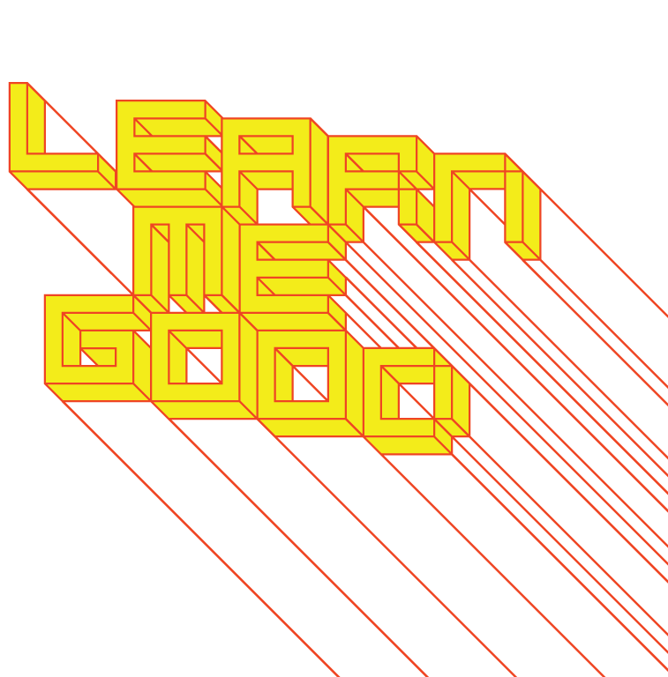
WEEK 8

Slide 2
week 8: flow: participatory design + pleasure
+ Class schedule:
+ Presentation: Creativity, Flow and the Everyday (~60:00)
+ 2019 National Design Triennial: Nature
+ Paola Antonelli describes what makes good design
+ Book review recommended for today, but due by the end of semester (Moodle)

Slide 3
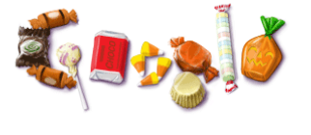
week 8: flow: participatory design + pleasure
+ What Makes Designers So Brilliant, Special, Important, Irreplaceable (and Humble)?
+ Answer: Nothing and Everything
+ John Thackara: + "A better innovation approach is to switch attention from science dominated
futures to social fictions in which imagined new contexts enrich an otherwise familiar world.
Design scenarios are powerful innovation tools because they make a possible future familiar and
enable the participation of potential users in conceiving and shaping what they want."
+ Ezio Manzini: "disabling" versus "enabling" solutions
+ Self-service economy
+ Thackara: "What service designers refer to as sweet spots - instances in which real value is
created - occur at the intersection of latent social needs, open systems, smart consumers,
and smart companies."
+ Donald Norman: "We Are All Designers"
+ Survey of individuals' most loved and hated objects
+ Behavioural, aesthetic, reflective design (trust, service, fun)
+ "I still tell people about my experience, years ago, with the Austin Four Seasons Hotel. I
checked into my room to find a TV Guide on the bed, with a bookmark placed on the
current date."
+ "Something that puts a smile on my face every time I visit the site is that the logo on the
site 'Google' is like a little cartoon that changes
with relevance to something current. They
will have a little devil peeking through the O for
Halloween, or some snow caps on it
during winter. I just love that."

Slide 4
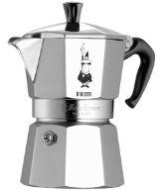
week 8: flow: participatory design + pleasure
+ Donald Norman: "We Are All Designers"
+ Endearing Objects
+ "I love my espresso machine. Oddly not because of its ease-of-use (it hasn't got much!) but
because it makes great coffee when you know how. It requires skill and the successful
application of that skill is rewarding."
+ Lack of usability has reflective appeal
+ How can mass produced things have personal meaning?
+ "The attributes that make something personal are precisely the sorts of things
that cannot be designed ahead of time, especially in mass production."
+ Customization: prescriptive, limited set of options
+ Mass customization: made-to-order using new technologies (body scanners, etc.)
+ Less waste and dead stock for manufacturers (just in time)
+ However, it is not possible to design a radically different form
+ These techniques can enhance functionality, but it doesn't guarantee emotional attachment
+ "Things do not become personal because we have selected some alternatives from a catalog
of choices. To make something personal means expressing some sense of ownership, of
pride. It means to have some individualistic touch."
+ Lived experience leads to attachment (i.e. a building changes as tenants arrange furniture,
move out, and are replaced by new occupants)
+ "The trick is to make objects that degrade gracefully, growing old along with their owners in a
personal and pleasurable manner."

Slide 5
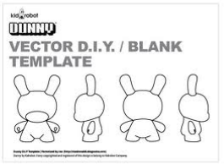
week 8: flow: participatory design + pleasure
+ Donald Norman: "We Are All Designers"
+ Approaches to Customization
+ Live with it: not optimal experience, but low cost justifies the difficulties and frustrations
+ Customize: flexible design to allow adaptation; too many options add unnecessary complexity
(i.e. software preferences)
+ Customize the use (i.e. customize a piece of furniture through placement and use, not the
object itself)
+ Customized mass production: manufactured to order
+ Design our own products: revert to "old days" of self-production or local craftsperson
(Shapeways, Spoonflower, Lulu, etc.)
+ Modify purchased products: unique personal expression
(cars, clothing, Dunny, etc.)
+ We Are All Designers
+ Steve Harrison and Paul Dourish: "A space can only be made into a place
by its occupants. The best that the designer can do is
put the tools into their hands."
+ We modify our environments to suit our needs: select, purchase, arrange,
restructure, replace, discard, etc.
+ This process of transformation gives control over the anonymous, generic items of
mass-production
+ "The best kind of design isn't necessarily an object, a space, or a structure: it's a process -
dynamic and adaptable. Many a college student has made a desk by placing a flat-sided door on top of two filing cabinets. Boxes become chairs and book cases. Bricks and wood make shelves. Rugs become wall hangings. The best designs are the ones we create for ourselves."

Slide 6
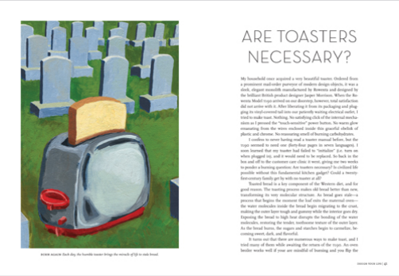
week 8: flow: participatory design + pleasure
+ Ellen Lupton: Design Your Life (35:00)
+ Donald Norman: "Professional designers can make things that are attractive and that work well.
They can create beautiful products that we fall in love with at first sight. They can create products
that fulfill our needs, that are easy to understand, easy to use, and that work just the way we want
them to. Pleasurable to behold, pleasurable to use. But they cannot make something personal,
make something we bond to. Nobody can do that for us: we must do it for ourselves."

Slide 7
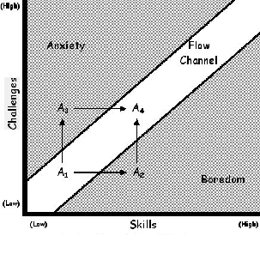
week 8: flow: participatory design + pleasure
+ John Thackara: Flow
+ How can we design systems, artifacts and experiences to facilitate flow in everyday life?
+ Maximize relationship between skills/challenges, control/arousal, spontaneous/familiar
+ Create active engagement and a positive sentiment
+ Complex Systems
+ "The Catalan economist Manuel Castells describes the modern world as a 'space of flows' - flows
of people, capital, information, technology, images, sounds, and symbols. 'Flows are not just
one element of social organization,' says Castells, 'they are the expression of the processes
dominating our economic, social and symbolic life.'"
+ Design in a complex world: involves redesign of the space of flows
+ Focus on how things work, rather than what they look like
+ Theodor Zeldin: Our age is one in which "deliberation replaces specification"
+ Seven Design Frameworks:
+ From blueprint and plan to sense and respond
+ From high concept to deep context
+ From top-down design to seeding edge effects
+ From blank sheets of paper to smart recombination
+ From science fiction to social fiction
+ From designing for people to designing with us
+ From design as project to design as service

Slide 8
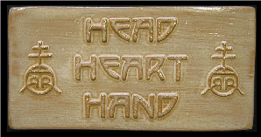
week 8: flow: participatory design + pleasure
+ John Thackara: Flow
+ Traditional design: "decompose" problems into smaller steps, then prioritized in lists
+ Top-down, outside-in approach
+ "It doesn't work well now because complex systems, especially human-centered ones, won't sit
still while we redesign them. A sense-and-respond kind of design seems to work better: Desired
outcomes are described, but not the detailed means of getting to those outcomes."
+ Responsive to events in a context; respond quickly and appropriately when reality changes
+ Focus on principles of relationship, connection, communication, and interaction
+ Complexity: the desired outcomes are not static
+ "designing as steering more than designing as shaping"
+ Hippocrates: "The greater part of the soul lies outside the body ... treatment of the inner requires
treatment of the outer."
+ Innovation is the ability to be responsive to context
+ The Tipping Point (Malcolm Gladwell): small changes transform the entire, larger system
+ "Networks and systems in nature generally start out small and develop during a process of
gradual growth. That's also how we should design man-made ones: Act lightly, sense the
feedback, act again."
+ Iteration: this is largely unconscious and intuitive in the
creative process (Flow)
+ Seamless, interconnected exchange between
head, heart and hand (William Morris)

Slide 9
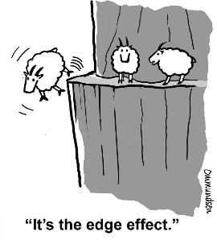
week 8: flow: participatory design + pleasure
+ John Thackara: Flow
+ The "Edge Effect"
+ Greater variety and density of organisms clustered along boundaries
+ The "edge of chaos": crystal (perfect internal order = stasis) versus boiling water (little order to be
changed = active)
+ Edward O. Wilson: systems that evolve most rapidly "must fall between, and more precisely on
the edge of chaos - possessing order, but with the parts connected loosely enough to be easily
altered either singly or in small groups."
+ Isolation of discrete practices or domains: more difficult to address conceptually multi-dimensional
issues
+ "If our connections to the edge are inadequate, we find it hard to figure out what people really
need and end up pushing products that they don't."
+ We need peripheral vision
+ Think about gateways, thresholds, port cities - places of connection
and exchange
+ "We need to become hunter-gatherers of ideas and tools:
How have other societies lived in the past? How do societies
live in oilier parts of the world today? Has this question been
answered somewhere else already?"
+ Instead of always starting from scratch, look abroad to see what
has already been resolved
+ Innovate by learning from the world: recombine relationships
(people, ideas, organizations)

Slide 10
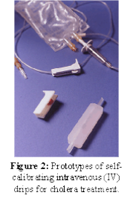
week 8: flow: participatory design + pleasure
+ Open Source/Crowd Sourced Intelligence Gathering
+ New models that refute the "point-to-mass paradigm"
+ ThinkCycle: web-based design project to develop a cheaper IV-drip system to
address emergency cholera outbreaks
+ Physicians, engineers, designers, and amateurs contributed
+ Result: $1.25 to manufacture, as opposed to $2000
+ Thomas Goetz: "Open source harnesses the distributive powers of the
Internet, parcels the work out to thousands, and uses their piecework
to build a better whole ... it works like an ant colony, where the
collective intelligence of the network supersedes any single contributor."
+ The ability to use, circulate, refine previous creations provides greater possibility for innovation
+ Find ways to share a vision among a community of "actors" and stakeholders
+ Adaptation
+ Design is a fluid process that constantly defines a system's rules rather than outcomes (not
product-centric)
+ "Against this backdrop of situations in which systems don't stop changing, the idea of a self-
contained design project - of 'signing off' on a design when it is finished - makes no sense. A
project-based business model in design is like a water company that delivers a bucket of water
to your door and pronounces its mission accomplished."
+ Designing with, not for, people
+ Donald Norman: "When something gives pleasure, when it becomes a part of our lives, and when
the way we interact with it helps define our place in society and in the world, then we have love.
Design is part of this equation, but personal interaction is the key. ... These are our bonds, to
ourselves, to our past, and to the future.

Slide 11
week 8: flow: participatory design + pleasure
+ Good Design?
+ 2019 National Design Triennial: Nature
+ Paola Antonelli describes what makes good design

Slide 12
week 8: flow: participatory design + pleasure
+ Assignment: Je me souviens (Part 2 due March 31; Groups of 3; 20%)
+ Suggested Framework (Similar criteria to Part 1)
+ Section I: Observation (500 words):
+ Ia: Briefly explain your choice; identify date/name of designer (if known); succinctly state its major
positive attributes (100 words)
+ Ib: Provide a brief history of your artifact/space, including key dates/transitions (100 words)
+ Ic: Provide a description of its visual and physical characteristics; include a map denoting its location
in the city (150 words, plus 10 photos/captions)
+ Id: Include a detailed description of its contextual environment (150 words); consider
+ Surfaces: hard/soft; changing/static
+ Size or volume: interior/exterior; confined/walled/open; reverb/echo/flat
+ Variety: balance of natural/human/manufactured phenomena; contrasts/similarities
+ Qualities: loud/quiet; harsh/sharp/soft/gentle
+ Layers: multiple simultaneous/discrete; easily-distinguished/seamless blend
+ Make sure that your photographs reveal different facets of the artifact
+ Verify that you are able to photograph in-situ (i.e. not private property)

Slide 13
week 8: flow: participatory design + pleasure
+ Section II: Occupation (500 words)
+ IIa: How does the general public interact with your artifact? Who, how, when, and under what
circumstances? Does this change during the day or seasons? Is it available to all, or restricted to a
specific demographic? (250 words)
+ IIb: Consider the functionality of your artifact (perceived/purported practical functions). Is there a
discrepancy between this and the experience of the user? Can this be quantified? (250 words)
+ Section III: Analysis (500 words)
+ IIIa: Apply principles studied in DART 261/262 to justify your assessment
+ As a starting point, consider Dieter Rams' Ten Principles for Good Design
+ Consider durability of your artifact: both physical and emotional
+ Is your artifact healthy: physically, environmentally, socially?
+ Does it help the public in positive ways (not mere ornamentation)?
+ Is it responsive to human scale? Does it evoke a positive sentiment?
+ You must integrate a minimum of 3 sources from the course or elsewhere

Slide 14
week 8: flow: participatory design + pleasure
+ Section IV: Proposal (400 words)
+ Propose a solution to rectify the problems identified in the analysis
+ Provide sketches, diagrams, and a 400-word written description of the changes
+ This will lead up to Part 3 of the assignment, which will entail a 3-poster set
+ You may wish to divide up the sections among your team members to make the most optimal use of
your time/energies
+ Section V: Conclusion (100 words)
+ Succinctly describe your reasoning for the positive assessment
+ How does it activate and reflect the culture of its time and place?
+ If your artifact is historical, how does it function today?
+ Oral Presentation (Week 11/12)
+ Each team will present their research and proposals in 10-15-minute sessions
+ 5-minute (MAX!) video presentation, followed by Q&A session
+ It is recommended that you use a video sharing site (YouTube, Vimeo, etc.) and provide a link
+ All files MUST be uploaded to Moodle prior to the class session to expedite the process
+ Order will be determined randomly
+ You MUST attend all sessions

Slide 15
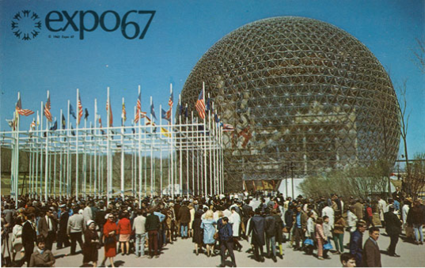
week 8: flow: participatory design + pleasure
+ Deliverables:
+ Approximate length: 2000 words, plus captions (PDF FORMAT ONLY)
+ 5-minute video presentations, followed by 10-minute discussion in week 11/12 (randomly selected)
+ Photographs and captions should be integrated into the body of the text
+ Upload one copy to the Moodle

Slide 16
week 8: flow: participatory design + pleasure
+ Ready, Set, Go!
+ For Next Week:
+ Read: Gaver, Bill. “Designing for Homo Ludens.” pp. 163-178
+ Respond to Moodle Prompt:
+ Please post a summary of the tutorial session focused on developing/curating a
design exhibition. Upload your response to the week 8 Moodle forum.
+ Continue development and research on Part 2 of the Je me souviens assignment with your team

