Slide 1
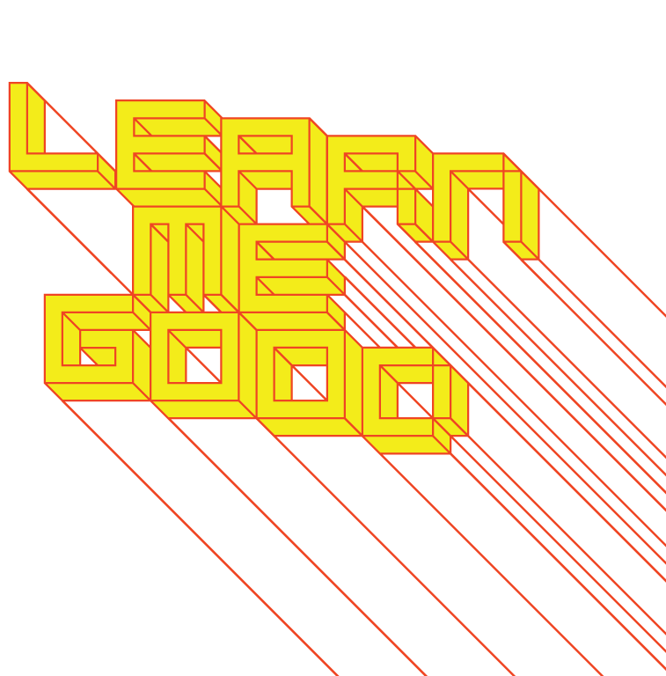
WEEK 9

Slide 2
week 9: homo ludens: play-based methodologies
+ Class Schedule:
+ Presentation: Productive Play
+ Play Session
+ Rapid prototyping and play-based methodologies

Slide 3
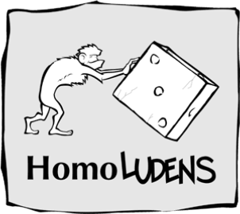
week 9: homo ludens: play-based methodologies
+ Bill Gaver: “Designing for Homo Ludens”
+ What are "Homo Ludens"?
+ "Man the player" / "playing man" (Johan Huizinga, 1938)
+ Play is primary to, and necessary for, the propagation of culture
+ "Play theory" is the space in which play occurs: strong relationship to "flow"
+ Huizinga: "Play is older than culture, for culture, however inadequately defined, always
presupposes human society, and animals have not waited for man to teach them their playing."
+ Can be observed in all aspects of animal life
+ Characteristics of Play:
+ Play is free, is in fact freedom.
+ Play is not "ordinary" or "real" life
+ Play is distinct from “ordinary” life both as to locality and duration.
+ Play creates order, is order. Play demands order absolute and supreme.
+ Play is connected with no material interest, and no profit can
be gained from it.
+ Creativity and Play are Fundamentally Connected
+ “Wherever there is a catch-word ending in -ism we are hot on
the tracks of a play-community.”
+ Solar Pink Pong, Assocreation and Daylight Media Lab
(Roland Graf)

Slide 4
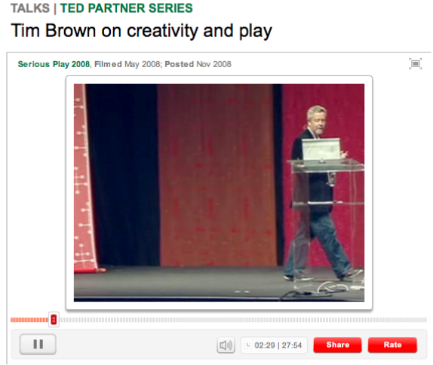
week 9: homo ludens: play-based methodologies
+ Tim Brown: "Serious Play: The Link Between Creativity and Play" (~30:00)
+ Worksheet
+ "All work and no play makes Jack a dull boy."

Slide 5
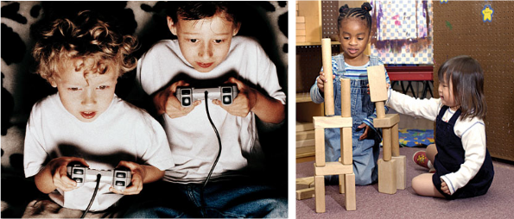
week 9: homo ludens: play-based methodologies
+ Bill Gaver: “Designing for Homo Ludens”
+ Computers and Play
+ The ubiquity of computers in everyday life means that they are no longer strictly for rational, task-
oriented uses
+ We are now free to dream up new uses, new interfaces, new experiences
+ "From this perspective, we are characterised not just by our thinking or achievements, but by our
playfulness: our curiosity, our love of diversion, our explorations, inventions and wonder.
An aimless walk in the city centre, a moment of awe, a short-lived obsession, a joke--all are
defining and valuable facets of our humanity, as worthy of respect as, planning, logic or study."
+ Play is a Serious Business
+ Not merely useless entertainment
+ "Competitive" play (governed by rules, hierarchies and rituals) is not the same as
"self-determined" play

Slide 6

week 9: homo ludens: play-based methodologies
+ Bill Gaver: “Designing for Homo Ludens”
+ Allan Kaprow: "[A] critical difference between gaming and playing cannot be ignored. Both involve
free fantasy and apparent spontaneity, both may have clear structures, both may (but needn't)
require special skills that enhance the playing. Play, however, offers satisfaction, not in some stated
practical outcome, some immediate accomplishment, but rather in continuous participation as its
own end. Taking sides, victory, and defeat, all irrelevant in play, are the chief requisites of game. In
play one is carefree; in a game one is anxious about winning."
+ Gaming Versus Playing
+ Play as an alternative to work is not the same as pre-programmed entertainment
+ Gaming has rules, right and wrong responses, problems to solve and clear objectives
+ The "fun market" cultivates an artificial sense of play
+ Does not pose the potential for new models, new alternatives and "what ifs?"
+ Play is open-ended--no fixed path or outcome
+ Rules or provisionary goals may emerge, but are not scripted from the outset
+ The motivation is purely internal (or, perhaps prompted, but we accept the terms)
+ Dr. Seuss: "These things are fun and fun is good."

Slide 7
week 9: homo ludens: play-based methodologies
+ Bill Gaver: “Designing for Homo Ludens”
+ How Do We Design for Homo Ludens?
+ There must be a sense of wonder, bewilderment, or stimulating provocation
+ "Designing for uncommon activities and strange orientations"
+ Challenges assumptions and breaks down the fear of "not getting it"
+ The user must identify personal motivation
+ We must be conscious about audience and perceptions about becoming merely transgressive
+ The design must apply "traditional" approaches that mandate and support the activities and
interpretations
+ This establishes trust, safety, reliability and allows users to take your design seriously
+ Increased Focus on Designing New Interactions
+ Not designing new "things" to solve problems, but cultivating experiences
+ Allow for exploration and interpretive ambiguity
+ Concrete goals are relinquished
+ Preferred or established modes of thought/action disappear
+ Offer resources for users to perform as they see fit
+ Highlight richly-suggestive areas for exploration, rather than being entirely open-ended
+ Design as "framer"
+ The experience must be pleasurable beyond basic entertainment
+ Gilda Radner: "Some stories don't have a clear beginning, middle, and end. Life is about not
knowing, having to change, taking the moment and making the best of it, without knowing
what's going to happen next. Delicious ambiguity..."

Slide 8
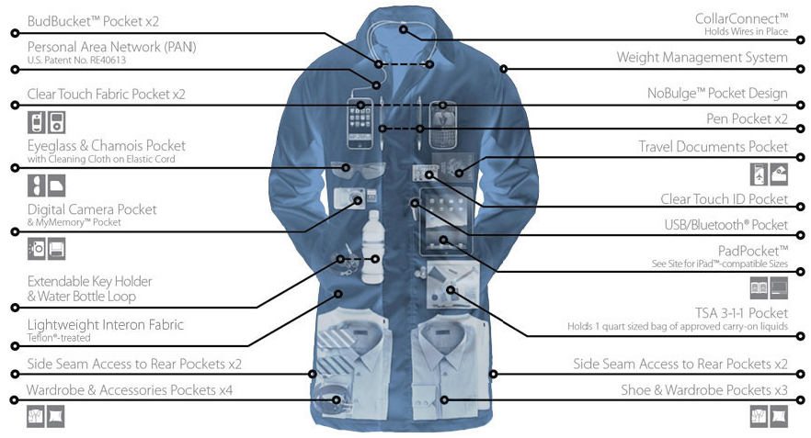
week 9: homo ludens: play-based methodologies
+ Scottevest/SeV, Carry-On Coat (2010)
+ In 2024, airlines around the world took in a collective haul of $148.4 billion in ancillary fees and
charges, all of it non-taxable

Slide 9
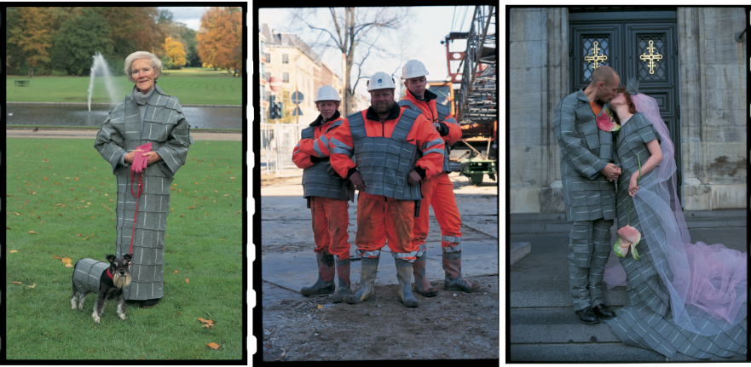
week 9: homo ludens: play-based methodologies
+ Fortunecookies.dk, Felt 12 x 12 (2001)
+ "Our aim with the workshop in Øksnehallen was to leave clothing design to the consumer's
imagination. The aim of the workshop was to give the consumer the freedom to be creative with our
product..."

Slide 10
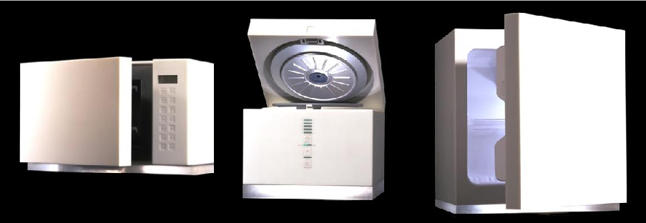
week 9: homo ludens: play-based methodologies
+ Elephant Design, Insipid Collection (2000)
+ "Elephant design aims to help individuals get what they really want, by promoting the development
and production of users' innovative proposals, from ideal wishes into actual products. ... Our
concept of 'When demand meets supply' seeks to integrate users' innovation into the product
development process... This concept enables designers and firms to gain access into individual
users needs in advance, and thus avoid costly product failures."

Slide 11
week 9: homo ludens: play-based methodologies
+ Bill Gaver: “Designing for Homo Ludens”
+ Round Two: How Do We Design for Homo Ludens?
+ Balance the rational, systematized approach with a more personal play-based strategy
+ "It is difficult to conceive of a task analysis for goofing around, or to think of exploration as a
problem to be solved, or to determine usability requirements for systems meant to spark new
perceptions. Instead, designers need to use their personal experiences as sounding boards for
the systems they create."
+ Consult with the intended user group/profile
+ Design exercises to provoke and get at the heart of what they value--"probe materials"
+ Ambiguity
+ "Contrary to traditional thinking about interaction, ambiguity is an invaluable tool because it allows
people to find their own meaning in uncertain situations. Used in design processes, concepts
and products, ambiguity gives space for people to intermesh their own stories with those hinted
at by [the design]."
+ A well-conceived design is completed by the users
+ "... designs are not hypotheses to be tested simply as true or false, successful or unsuccessful.
They may be approached at multiple levels, ranging from the aesthetic to the conceptual and the
personal to the cultural. They may be experienced by the same person at different times, by
different people and groups of people, and in different settings and circumstances."
+ "... pleasure comes before understanding, and engagement before clarity."

Slide 12
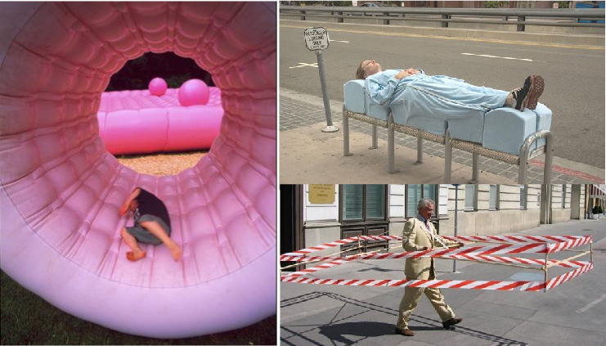
week 9: homo ludens: play-based methodologies
+ Actions: What You Can Do With the City (CCA, 2009)
+ Topotek 1, Temporary Playground + Sarah Ross, Archisuit
+ Hermann Knoflacher, Gehzeug
+ We have lost our sense of public and private spaces
+ What is socially, legally, or ethically permissible? Are there ways to reclaim our shared domains?

Slide 13
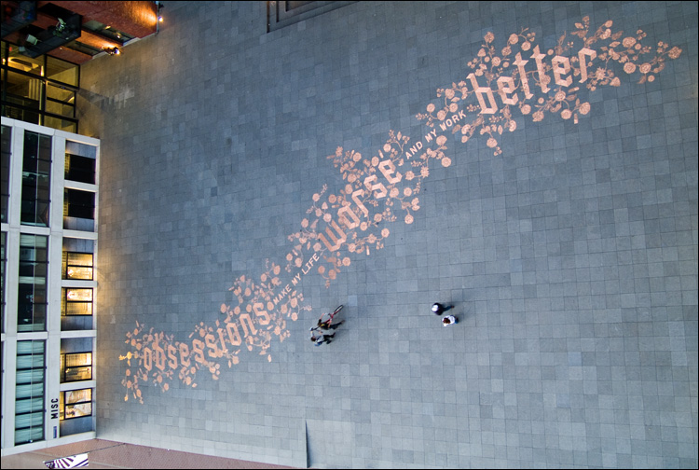
week 9: homo ludens: play-based methodologies
+ Urban Play (Amsterdam, 2008)
+ "Urban Play poses the question that we hear so much about the “creative city”, but when to we
actually get to see it in action? ... the exhibition explored how this latest wave of interaction with the
urban landscape is challenging the rules of engagement between citizens and sanctioned urban
creative expression–moreover, how it is changing the language of creativity in the city."

Slide 14
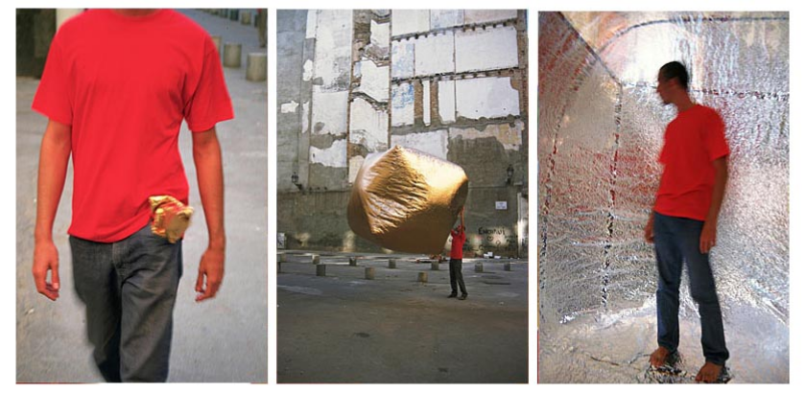
week 9: homo ludens: play-based methodologies
+ Martin Ruiz de Azua, Basic House (2000)
+ "Our habitat has turned into a place of consumption in which an unlimited number of products satisfy
a series of needs created by complex relations difficult to control. Cultures that keep a more direct
relation with their environment demonstrate to us that the habitat can be understood in a more
essential and reasonable way."

Slide 15
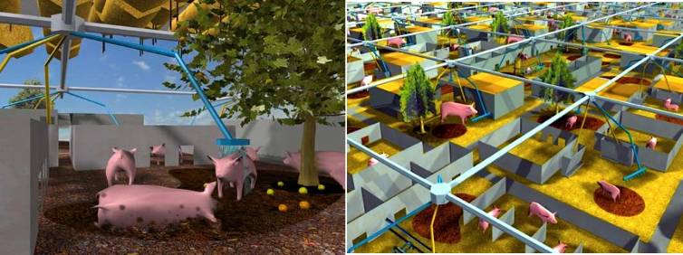
week 9: homo ludens: play-based methodologies
+ MVRDV Architects / The Why Factory, City Pig (2001/2009)
+ "In 2000, pork was the most consumed form of meat at 80 billion kg per year. Recent animal
diseases such as Swine Fever and Foot and Mouth disease are raising serious questions about
pork production and consumption. It is evident that the current pork industry cannot proceed in the
same way without causing many casualties... Let us assume that we remain pork-eaters. Do we
then have enough space for biological pig farming?"
+ Food Print Manhattan (2009)
+ Studio Profile

Slide 16
week 9: homo ludens: play-based methodologies
+ Assignment: Je me souviens (Part 2 due March 31; Groups of 3; 20%)
+ Montreal as a UNESCO City of Design
+ What makes a "design city"?
+ Select an example of what you feel to be well-designed
+ Architecture, public parks, systems, street furniture, infrastructure, etc.
+ MUST be Montreal-specific
+ "Even the city itself acknowledges that ‘design in Montreal is not simply for show but a source of
daily wellbeing.’ Not only has Montreal demonstrated that design can be a powerful tool in
promoting inclusion and plurality of values, but the city has also called upon its citizens to play a
critical and active part in mobilizing design to inspire more innovative living environments that
enhance daily life and existence.” --Koichiro Matsuura (UNESCO Director-General)
+ Not just a celebration of Montreal's attributes
+ The second part of this assignment addresses the less effective elements of the city
+ Think about inhabitation: how do these artifacts/experiences shape the daily life of citizens (for
better or for worse)?
+ Use the issues, frameworks, guiding principles explored in class
+ What contextual, semantic, and physical concerns need to be addressed/investigated?
+ Examine the patterns of use, appropriateness of material choices, and general mood/atmosphere
+ What prevents it from being workable/livable/enjoyable?
+ Why doesn't it provide a more positive contribution to the everyday experience?

Slide 17
week 9: homo ludens: play-based methodologies
+ Assignment: Je me souviens (Part 2 due March 31; Groups of 3; 20%)
+ Suggested Framework (Similar criteria to Part 1)
+ Section I: Observation (500 words):
+ Ia: Briefly explain your choice; identify date/name of designer (if known); succinctly state its major
positive attributes (100 words)
+ Ib: Provide a brief history of your artifact/space, including key dates/transitions (100 words)
+ Ic: Provide a description of its visual and physical characteristics; include a map denoting its location
in the city (150 words, plus 10 photos/captions)
+ Id: Include a detailed description of its contextual environment (150 words); consider
+ Surfaces: hard/soft; changing/static
+ Size or volume: interior/exterior; confined/walled/open; reverb/echo/flat
+ Variety: balance of natural/human/manufactured phenomena; contrasts/similarities
+ Qualities: loud/quiet; harsh/sharp/soft/gentle
+ Layers: multiple simultaneous/discrete; easily-distinguished/seamless blend
+ Make sure that your photographs reveal different facets of the artifact
+ Verify that you are able to photograph in-situ (i.e. not private property)

Slide 18
week 9: homo ludens: play-based methodologies
+ Section II: Occupation (500 words)
+ IIa: How does the general public interact with your artifact? Who, how, when, and under what
circumstances? Does this change during the day or seasons? Is it available to all, or restricted to a
specific demographic? (250 words)
+ IIb: Consider the functionality of your artifact (perceived/purported practical functions). Is there a
discrepancy between this and the experience of the user? Can this be quantified? (250 words)
+ Section III: Analysis (500 words)
+ IIIa: Apply principles studied in DART 261/262 to justify your assessment
+ As a starting point, consider Dieter Rams' Ten Principles for Good Design
+ Consider durability of your artifact: both physical and emotional
+ Is your artifact healthy: physically, environmentally, socially?
+ Does it help the public in positive ways (not mere ornamentation)?
+ Is it responsive to human scale? Does it evoke a positive sentiment?
+ You must integrate a minimum of 3 sources from the course or elsewhere

Slide 19
week 9: homo ludens: play-based methodologies
+ Section IV: Proposal (400 words)
+ Propose a solution to rectify the problems identified in the analysis
+ Provide sketches, diagrams, and a 400-word written description of the changes
+ This will lead up to Part 3 of the assignment, which will entail a 3-poster set
+ You may wish to divide up the sections among your team members to make the most optimal use of
your time/energies
+ Section V: Conclusion (100 words)
+ Succinctly describe your reasoning for the positive assessment
+ How does it activate and reflect the culture of its time and place?
+ If your artifact is historical, how does it function today?
+ Oral Presentation (Week 11/12)
+ Each team will present their research and proposals in 10-15-minute sessions
+ 5-minute (MAX!) video presentation, followed by Q&A session
+ It is recommended that you use a video sharing site (YouTube, Vimeo, etc.) and provide a link
+ All files MUST be uploaded to Moodle prior to the class session to expedite the process
+ Order will be determined randomly
+ You MUST attend all sessions

Slide 20
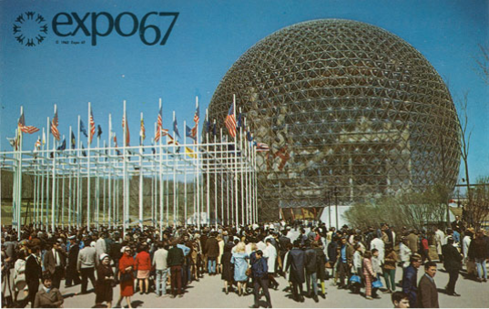
week 9: homo ludens: play-based methodologies
+ Deliverables:
+ Approximate length: 2000 words, plus captions (PDF FORMAT ONLY)
+ 15 minutes per team
+ 5-minute video presentations, followed by 10-minute discussion
+ Week 11/12 (randomly selected)
+ Be prepared to share your presentation
+ Photographs and captions should be integrated into the body of the text
+ Upload one copy to the Moodle folder

Slide 21
week 9: homo ludens: play-based methodologies
+ Ready, Set, Go!
+ For Next Week:
+ Read: Severs, Jason. “Design: A New Engine for Society.” Design Mind on GOOD
+ Read: Lawrie, Samantha. “Graphic Design: Can it be Something More?” (Library reserve)
+ Respond to the Prompt (Moodle):
+ Please post a response to the prompt outlined in the week 9 Moodle forum.
+ Be sure to include a photo of the rapid prototype!
+ Continue development and research on Part 2 of the Je me souviens assignment

